Slide 1
4-H
What it is

Slide 2
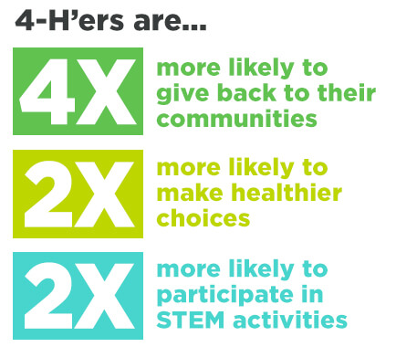
4-H is a U.S. Government network of youth organizations whose mission is “ engaging youth to reach their fullest potential while advancing the field of youth development
What is 4-H?

Slide 3
What do kids learn in 4-H?
Kids learn skills such as confidence and multiple life skills such as how to have good heath, how to do cool science experiments and are encouraged to participate in big leadership roles.

Slide 4
THE END

