Slide 1
U-2 Planes
By Kevin Lilienthal

Slide 2
The U-2 is a U.S. Air Force spy plane.
It can soar 13 miles above the earth.
U-2s fly so high that pilots must wear space suits.

Slide 3
How many miles can it fly above the Earth
Answer A. 3 miles
Answer B. 16 miles
Answer K.13 miles

Slide 4
Try again

Slide 5
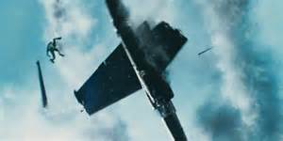
Nope

Slide 6
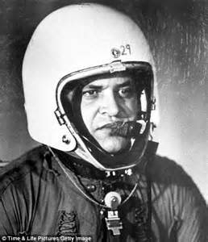
Correct

Slide 7
The End

