Slide 1
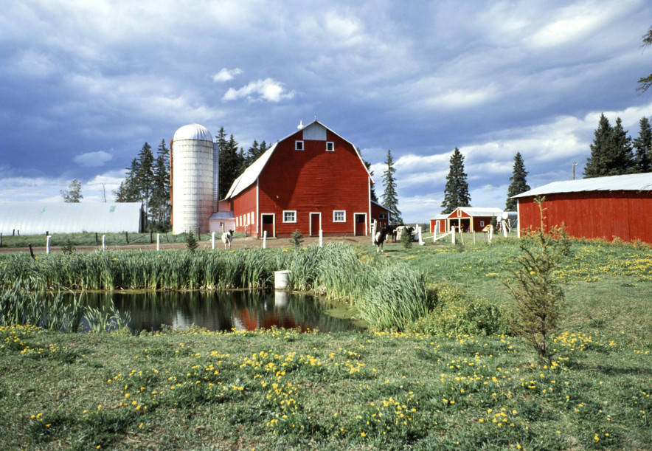
Agriculture related jobs in Nebraska
By Ashley

Slide 2
Field Service Technician
One is a field service technician, they work in a “field” as opposed to an office, laboratory, showroom, performance venue, school, or any other setting. He or she is also a “technician” as opposed to a manager, agent, engineer, sales rep or supervisor.

Slide 3
Crop Manager
The crop manager supervises every aspect of crop production ,from doing manual labor to handling administrative and business duties.

Slide 4
Agriculture Inspector
An agricultural inspector would inspect agricultural committees, processing equitment, and faculties, and fish and logging operations, to ensure compliance with regulations and laws governing health, quality, and safety

