Slide 1
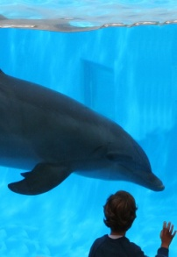
Dolfhins
Anna

Slide 2
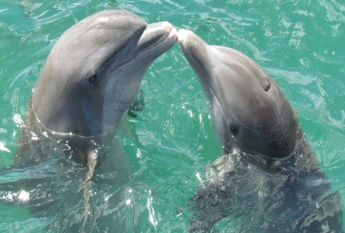
Where Found
Around the world

Slide 3
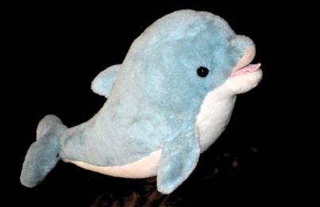
Habitat
Oceans

Slide 4
Predator
Large sharks

Slide 5
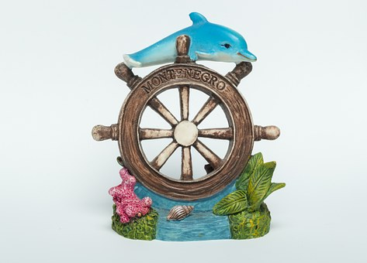
Food
Fish

Slide 6
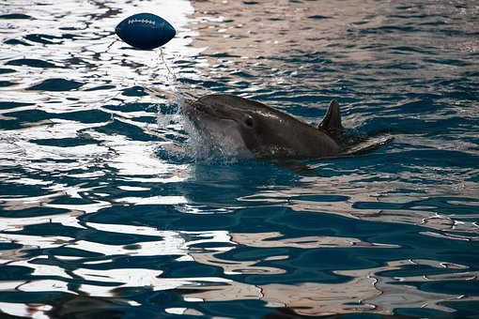
lifespan
20 years

Slide 7
Number of Newborn
1

Slide 8
Name of group
Pod team

Slide 9
weight
600 ponds

