Slide 1
Columbia
By Ashley Carlton

Slide 2
Location on world map

Slide 3
Capital City:
Santafé de Bogata
That’s exotic!

Slide 4
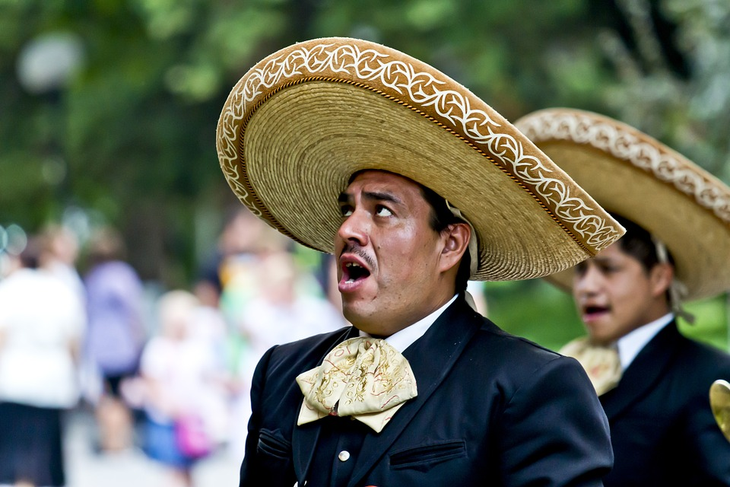
Language:
Spanish

Slide 5
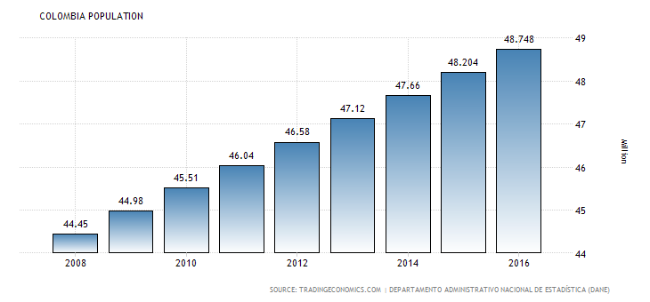
Population
48.65 million!

Slide 6
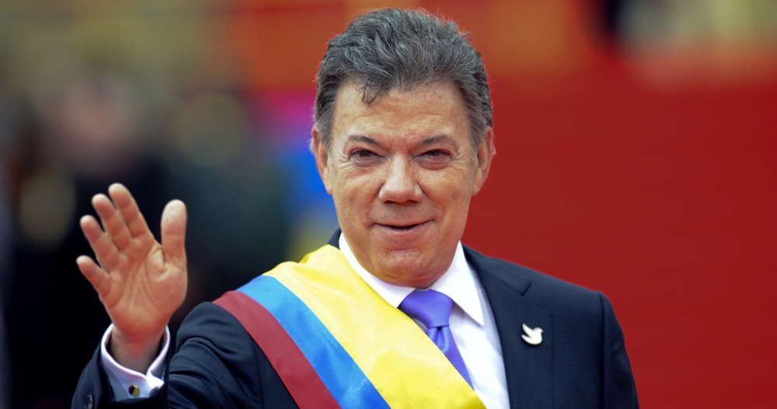
Current Leader
Juan Manuel Santos

Slide 7
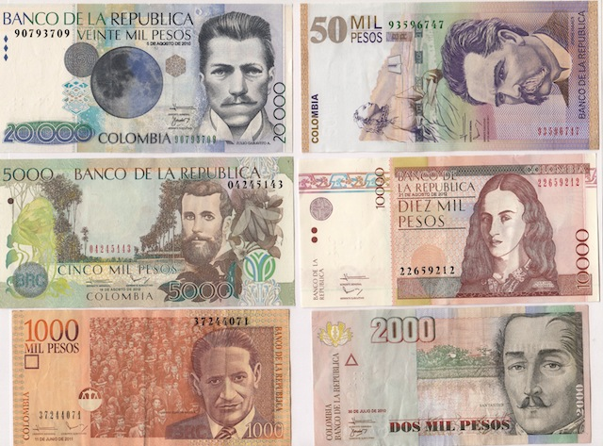
Currency
Columbian pesos

Slide 8
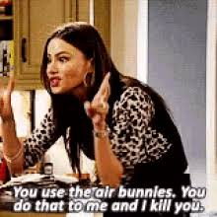
Famous people
Shakira
Sofia Vergara
Fanny Lu
Alex Vega
James Rodriguez Sofia Vergara
Carmen Villabobs

Slide 9
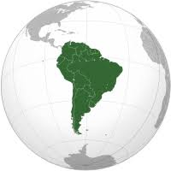
Continent
South America

Slide 10
Columbia’s Flag

Slide 11
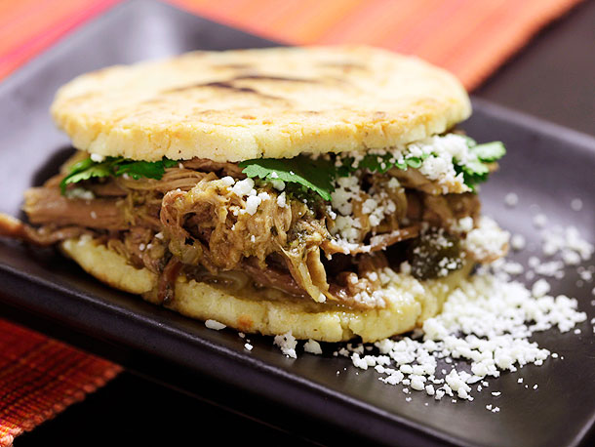
National Food
Arepa

Slide 12
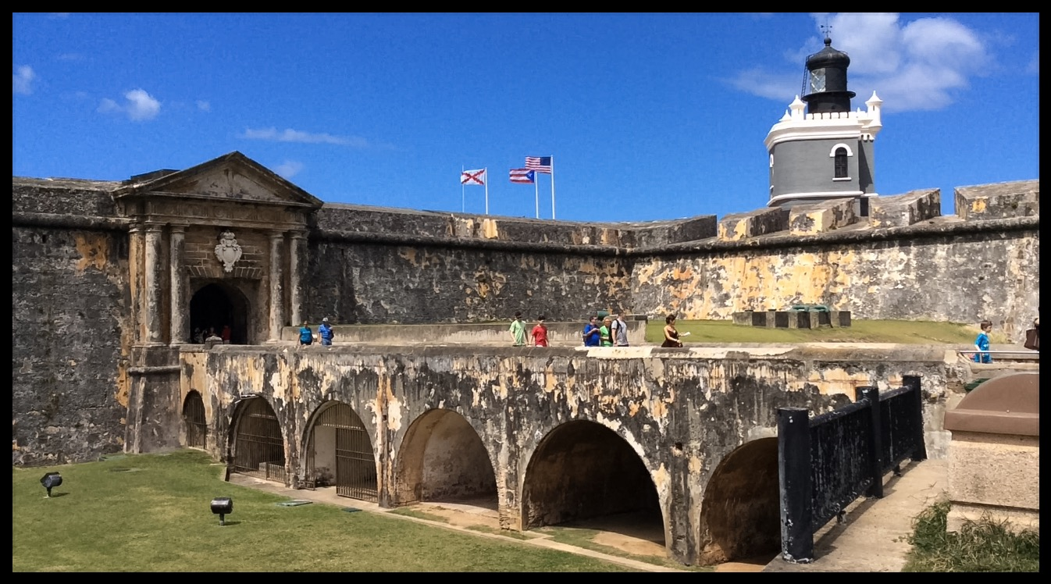
Landmarks
Fort of San Felipe

Slide 13
Thank You
This concludes my power point presentation, thank you for your attention.

