Slide 1
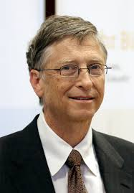
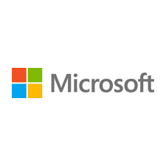
Bill Gates

Slide 2
Short bio
William Henry Gates III was born on October 28th 1955 in Seattle, Washington (Codim 17). Bills father, Bill Gates Jr., worked as a lawyer for a law firm and his mother, Mary, worked as a school teacher. Bill had an older sister, Kristanne, and a younger sister named Libby (http://www.teamgates.com/library/life.htm). Ever since Bill was born his family members gave him the nickname of Trey, after the III in his name (Dearlove 2).
Bills parents knew that he was an exceptional child and should get a better education than he would receive at a public school. For this reason his parents paid the $5,000 tuition to send Bill to Lakeside, one of the best private schools in the state of Washington (Codim 17). Bill excelled at mathematics and other subjects, but he soon found a place where he could devote his talents and interests. This place was the computer lab.
Computers were large and expensive in the 1960s so Lakeside had to buy time on DEC PDP-10 owned by General Electric (Mirick 22). Bill Gates and a few other students, including his best friend Paul Allen, quickly used up this computer time, spending hours at a time in the lab. The students formed the Lakeside Programmers Group and quickly outsmarted their

Slide 3
Fun Facts
1- Full Name Bill Gates’ full name is William Henry Gates III.
2- First Computer Program The first computer program that Bill Gates wrote was a tic-tac-toe game. The game was played in a 2 player format where the computer was the opponent.
3- Man of His Word Bill Gates is known to keep his word. In school he bragged to his teachers that he would be a millionaire by the time he was 30. Not only did he keep his word but he was a billionaire by 31.
4- Nickname Bill Gates’ kids often tease him by singing the song ‘Billionaire’ by Bruno Mars and Travis McCoy.
5- Education Bill Gates never graduated from college, instead founding Microsoft with his friend Paul Allen in 1975. He was just 20 years old when he founded Microsoft.

Slide 4
Cool video
https://www.youtube.com/watch?v=8TCxE0bWQeQ

Slide 5
About Microsoft
Microsoft Corporation /ˈmaɪkrɵˌsɒft/ or /-ˌsɔːft/^{[4]} is an American multinational corporation headquartered in Redmond, Washington, that develops, manufactures, licenses, supports and sells computer software, consumer electronics and personal computers and services. Its best known software products are the Microsoft Windows line of operating systems, Microsoft Office office suite, and Internet Explorer web browser. Its flagship hardware products are the Xbox game consoles and the Microsoft Surface tablet lineup. It is the world's largest software maker measured by revenues.^{[5]} It is also one of the world's most valuable companies.^{[6]}

