Slide 1
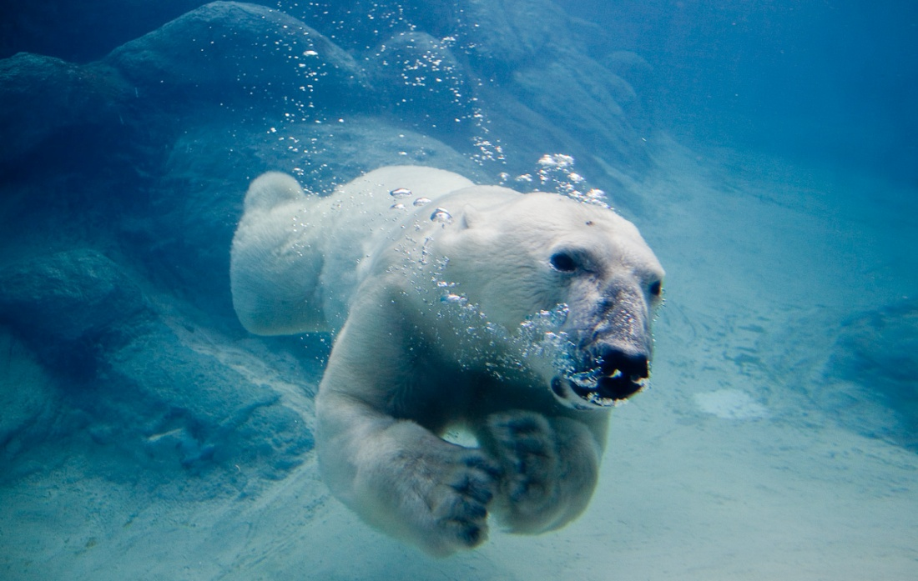
Polar Bears
Created By: Blake

Slide 2
Polar Bears are 11 feet tall.

Slide 3
Polar bears live in the artic.

Slide 4
Polar bears are 11 feet tall.

Slide 5
Some of them are marked with dye to keep records.

Slide 6
Polar bears eat seals.

Slide 7
Polar bears were very important to eskimos.

Slide 8
A polar bear has a long body and neck.

Slide 9
They can smell food from 10 miles away.

Slide 10
Polar bears are camoflodge.

Slide 11
Their fur is dense.

Slide 12
Ursus Maritimus is the scientific name for polar bears.

Slide 13
Resources
Leptien, Emile U. Polar Bears. Chicago, Illinois, U.S.A: Childrens press, 1991. Print.

