Slide 1
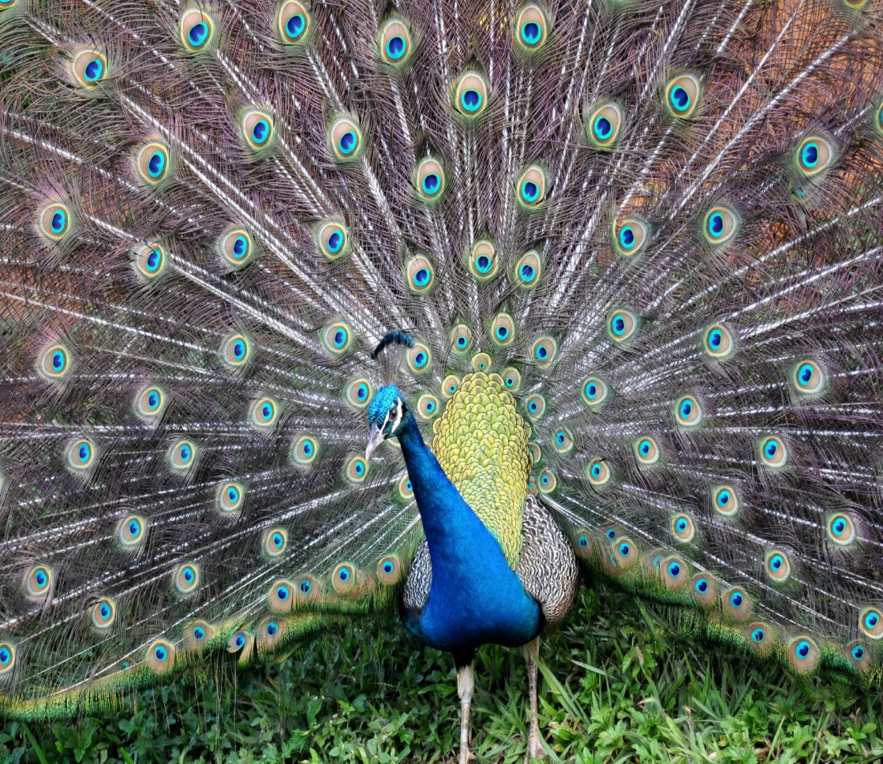
Peacock
Breanna

Slide 2
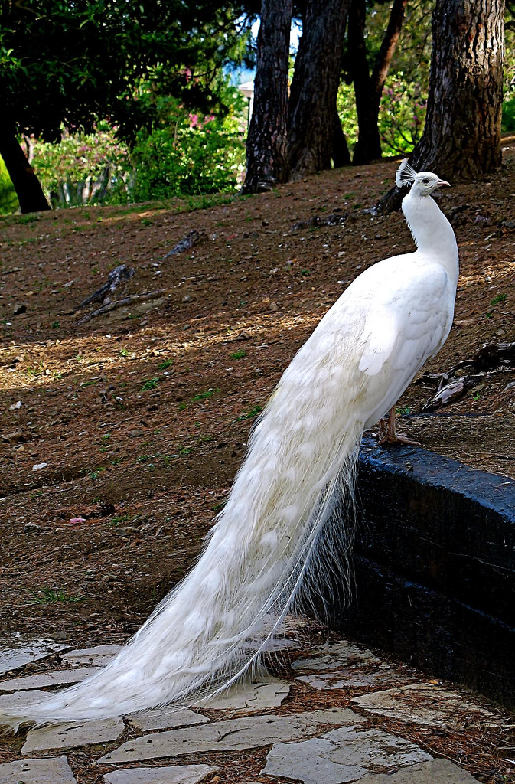
Where found
South Asia

Slide 3
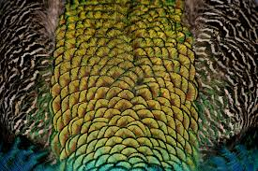
habitat
rainforest

Slide 4
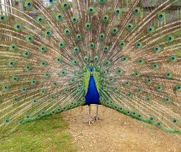
predators
People snakes and tigers

Slide 5
lifespan
About 20 years

Slide 6
food
snails, frog, grains, and grasses

Slide 7
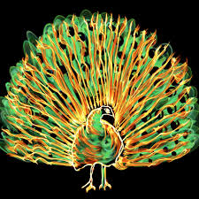
weight& & length & height
8 to 13 pounds 4 to 6 kilograms
4 to 6 feet 1.2 meters wings spread
4 feet 1.2 meters

Slide 8
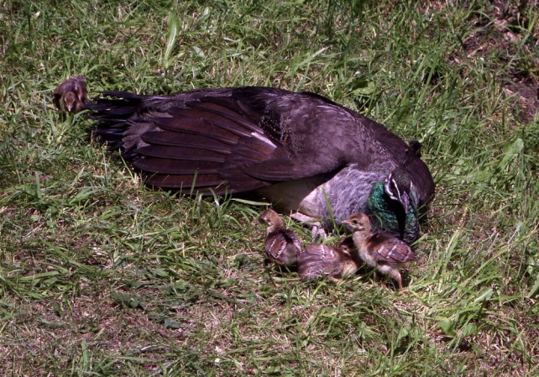
Number of newborn
3 to 8

Slide 9
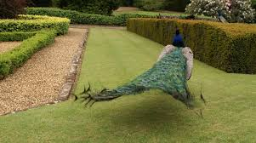
Name of group
Party,bevy

Slide 10
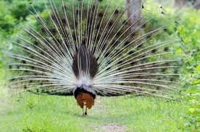
Size of group
One male usually form a group with 2 to 5 females

Slide 11
Conservation statis
Least concern

Slide 12
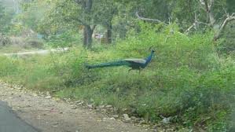
Scientific name
It is named Pavocristatus

Slide 13
Interesting fun fact
Only males have brightly colored tail feathers
They use their feathers to attract females

