Slide 1
by shay
Dan Gutman

Slide 2
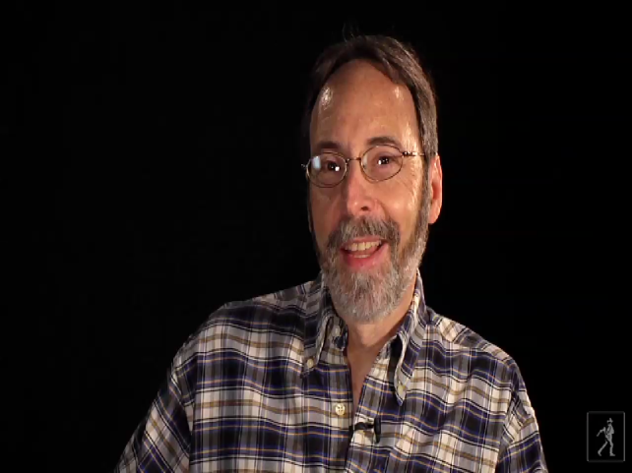
Dan Gutman

Slide 3
He was born in New York On October 19 1955
He attended rutgers in new brunswick,new jersey,graduating in 1977
His parents got divorced
He made a story about sports because he always had loved sports

Slide 4
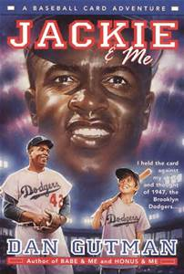
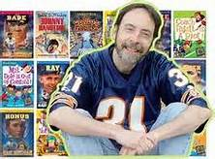

Slide 5
Mr harrison is embarrassin
It’s a teacher that is kind of weird that falls a lot and he aint smart
The kids think he is funny

Slide 6
He has a wife and two kids
He likes baseball
He used to be a newspapper colmist

