Slide 1
Chile
By chase

Slide 2
language
They speak Spanish

Slide 3
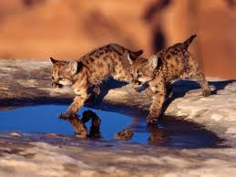
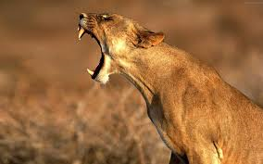
Wild life
They have lots of pumas

Slide 4
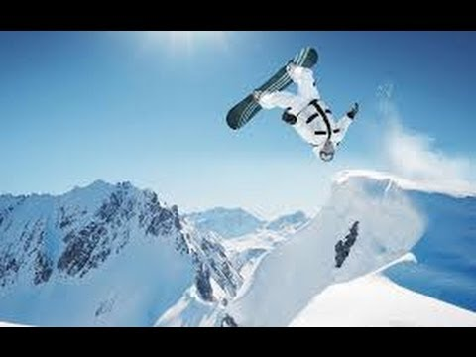
Sports
They snow board most the time in the Andes Mountains

Slide 5
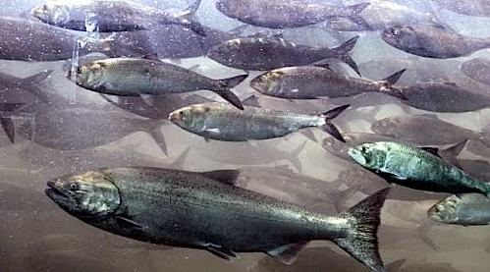
food
They have salmon. they have lots of salmon

Slide 6
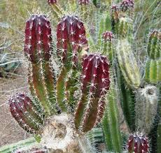
Plants/ they have cacti and they come in all different shapes

Slide 7
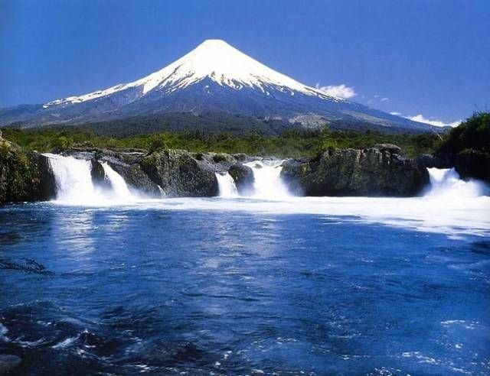
Mountains they have lots of volcanoes and mountains

Slide 8
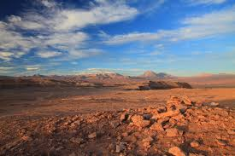
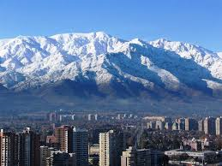
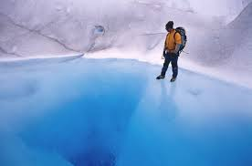
Climate of chili
They have hot and cold

Slide 9
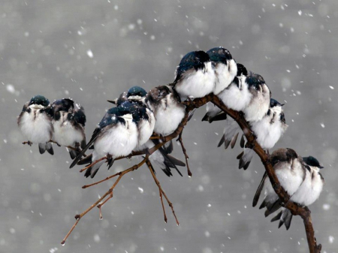
birds
These birds are at chile they are fat and like snow

Slide 10
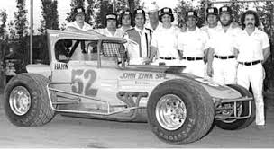
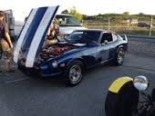
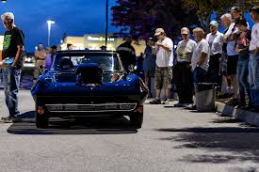
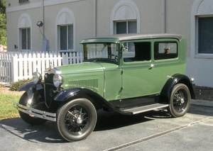
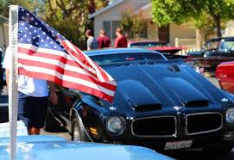
cars
They have lots of cool and hot cars .
They have race cars.

Slide 11
resources
BURGAN, MICHEAL. CHILE. NEW YORK, NEW YORK, USA: CHILDREN'S PRESS, 2010. Print

Slide 12
WHAT DOES MY COUNTRY SPEAK????????????????????????????????
Spanish
English
French
Italian

Slide 13
right

Slide 14
wrong

Slide 15
The end

