Slide 1
COOKATO
GARRETT

Slide 2
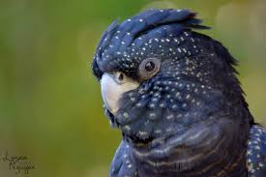
years
50 YEARS

Slide 3
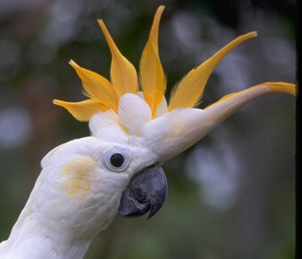
FUN FACT
THEY DO MANY TRICKS

Slide 4
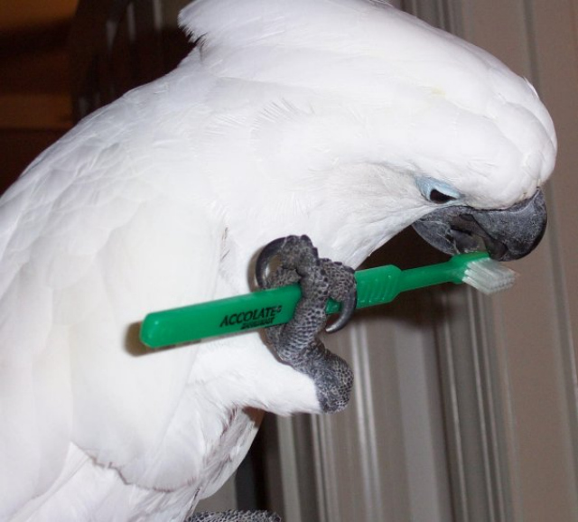
PLAYING WHITH
FUN PETS

Slide 5
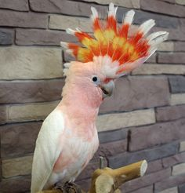
WHAT THEY LOOK LIKE
TALL FEATHERS ON THEIR HEAD

Slide 6
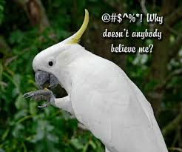
THEIR NAME
COOKTOO

Slide 7
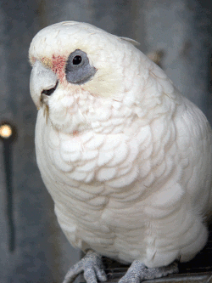
Fact
Large parrot

Slide 8
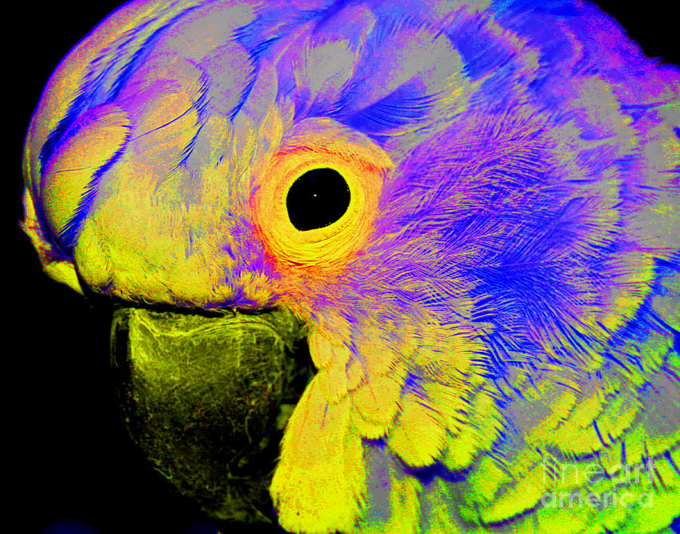
fact
Coocktoos can be many of colors

Slide 9
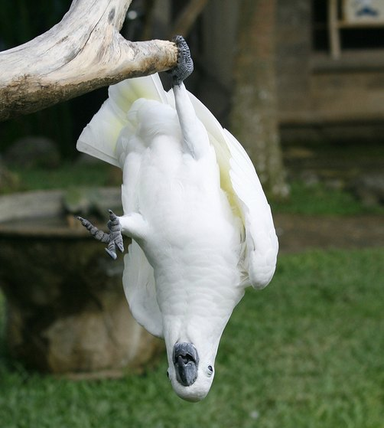
fact
Very strong legs

Slide 10
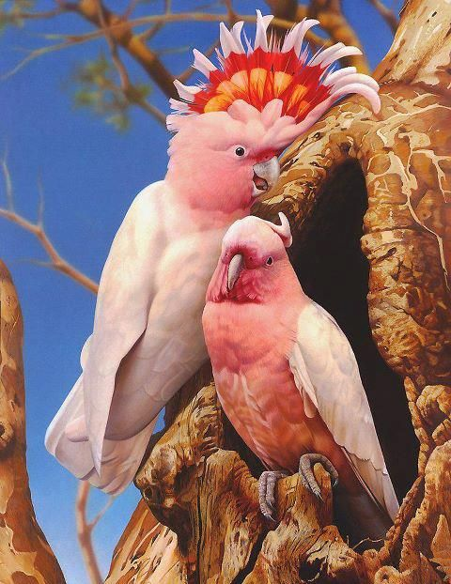
fact
41/2inches

Slide 11
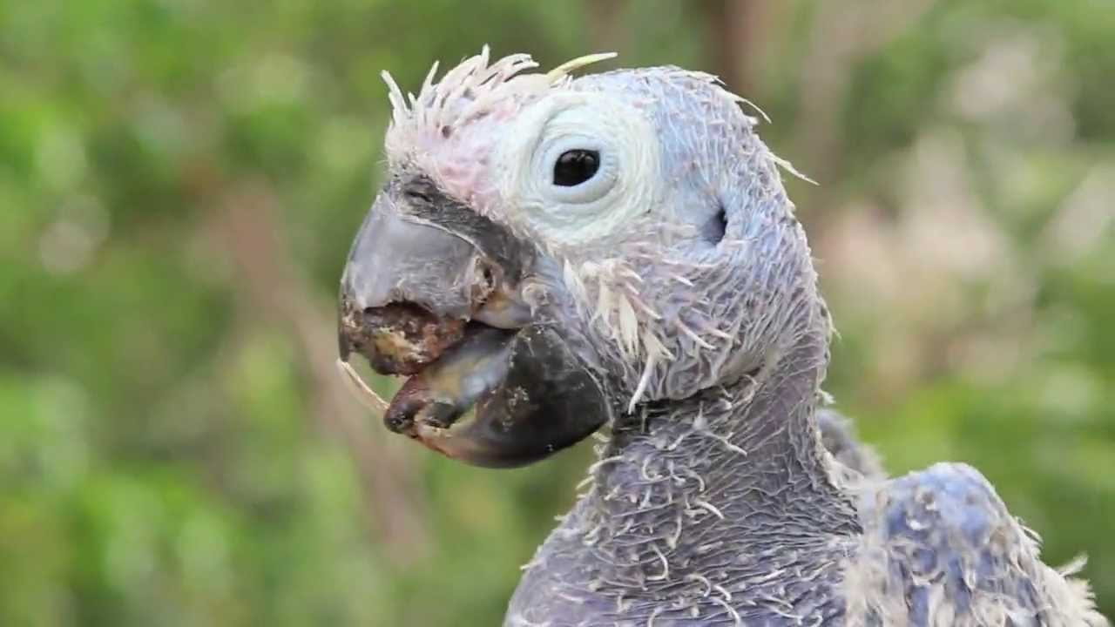
Life span
40 to 60 years 91 years old

Slide 12
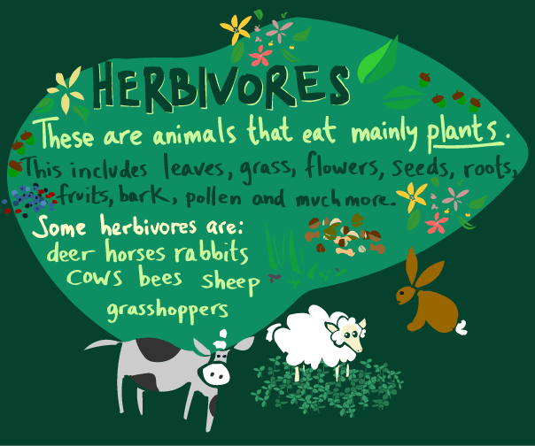
Diet type
herbivores

Slide 13
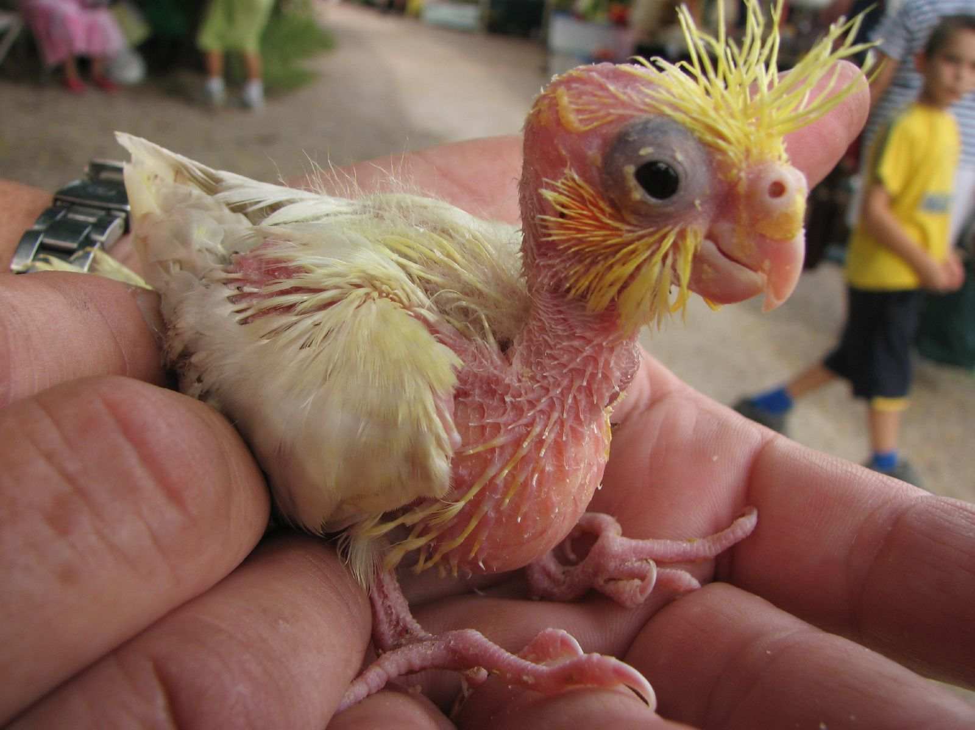
Name of young
chick

Slide 14
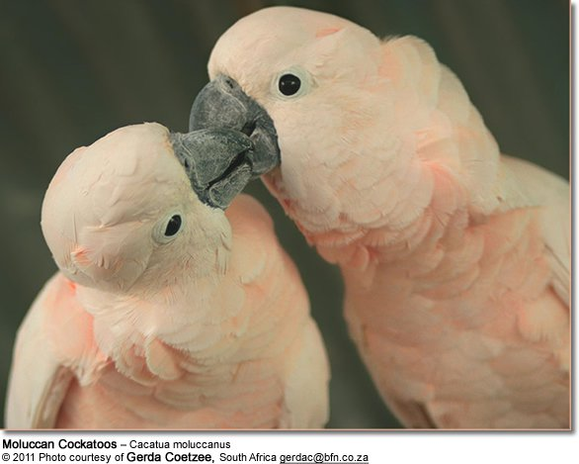
fact
Parents raise young together

Slide 15
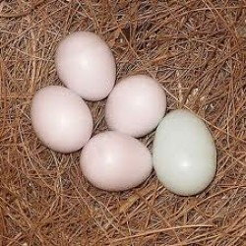
fact
eggs

Slide 16
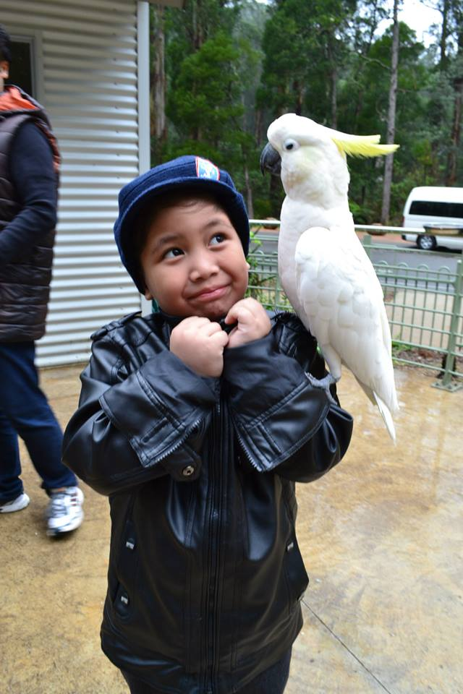
fact
Realy gentle

Slide 17
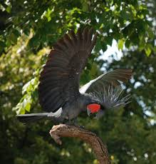
scietificname
Casta gakita

Slide 18
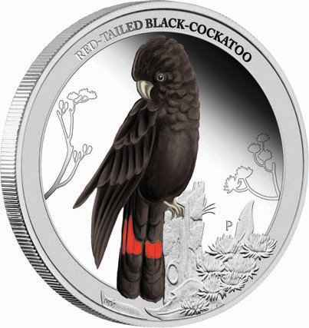
fact
20 inches long

Slide 19
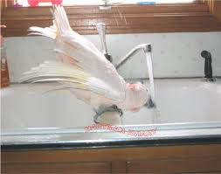
Fact
There funny

Slide 20
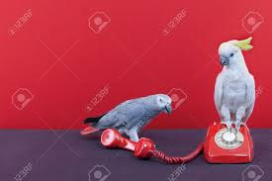
fact
They can talk

