Slide 1
Digital Citizenship
Online safety, social manners, and digital footprint

Slide 2
3 Little Pigs and the Big Bad Wolf Today

Slide 3
Digital Footprint
Everything on the internet about you!
Photos
Videos
Blog posts
Posting on others wall
Global audience
Can be viewed by people you don’t know
May be permanent
Content you publish
Content others publish about you

Slide 4
Digital Footprint

Slide 5
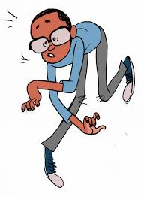
Tips to manage your footprint
Never post anything that may be embarrassing to you later
Be careful of the pictures that you post to your profile.
Do not post hurtful comments, insults or bully others
Change the privacy settings of your social networking so that only your friends may see your information
Do not share private information such as passwords or bank information - even in a private message as they can be hacked into.

Slide 6
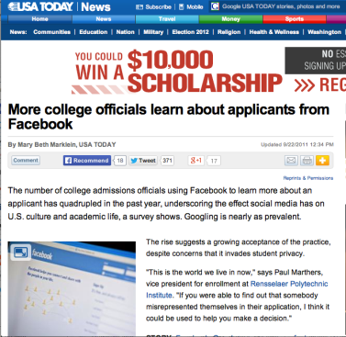
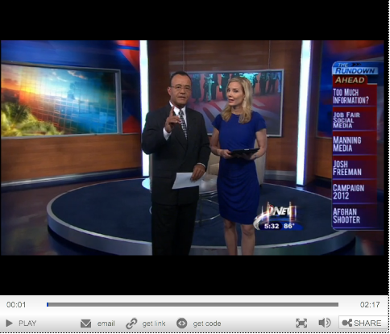
Protect your footprint
Why is it important?
Colleges and employers may check out your online reputation.
Colleges
Employers
Challenge!! - What does your footprint look like?
Google yourself! Type in your full name and hit enter.
Use Pipl to search yourself
https://pipl.com/

Slide 7
Social Media
Temporary Apps
Allow you to post for a short period of time - they disappear - Myth!
Person receiving can take a screen shot before it disappears.
Anything on internet can be recovered.
Anonymous Apps
Being incognito online helps us express ourselves
Can contain inappropriate material
Can lead to cyberbullying

Slide 8
Cyberbullying
Can be in the form of
Photos
Threats
Nasty comments
Humiliation
Anything posted can go viral on the internet with the click of a button

Slide 9
Cyberbully

Slide 10
Cyberbullying

Slide 11
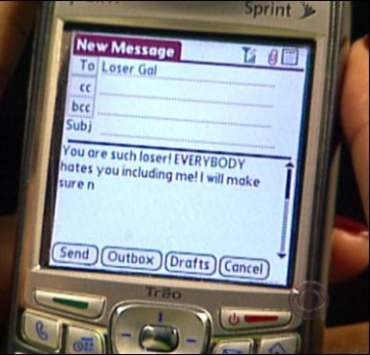
Tips on staying cyber safe
Never give out your full name
Never tell anyone where you go to school or work
Never give out your address or telephone number
Never agree to meet anyone from a chat room or social media site on your own
Tell an adult if someone makes inappropriate suggestions to you or makes you feel uncomfortable online

Slide 12
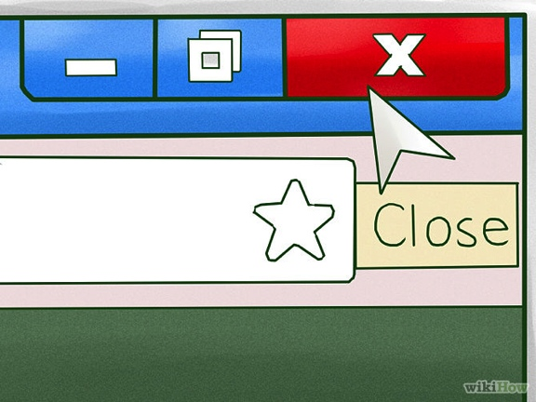
Cyber tips continued…
Only post what you want the world to see – what you post can be passed on and saved forever
Don’t share your password
Set your privacy settings for friends only – not public
If threatened - Close the app or program and report to an adult.

Slide 13
Once You Post

Slide 14
Think before you post!
Once you post information online
it may be almost impossible to remove because of file sharing.
Even though you deactivate your accounts, it still could be retrieved by others.

Slide 15
Parent Resources
NetSmartz
OnGuardOnline.gov
KidsEmail.org
"Digital Citizenship and Social Media for Parents and Students." Digital Citizenship and Social Media for Parents and Students. http://www.digcit4parents.com

Slide 16
Resources
"A Great Guide on Teaching Students about Digital Footprint ~ Educational Technology and Mobile Learning." A Great Guide on Teaching Students about Digital Footprint ~ Educational Technology and Mobile Learning. N.p., n.d. Web. 23 July 2014.
"Common Sense Media: Digital Footprint Intro." Vimeo. N.p., n.d. Web. 23 July 2014.
"Course: High School Digital Driver's License." Course: High School Digital Driver's License. N.p., n.d. Web. 23 July 2014.
"Five-Minute Film Festival: Teaching Digital Citizenship." Edutopia. N.p., n.d. Web. 22 July 2014.

Slide 17
Resources continued
"More College Officials Learn about Applicants from Facebook." USATODAY.COM. N.p., n.d. Web. 23 July 2014.
"Share Your Facebook Password during a Job Interview?" Medium Topper Video Player. N.p., n.d. Web. 23 July 2014.
"Your Photo Fate." Your Photo Fate. Net Smartz, n.d. Web. 23 July 2014. http://www.netsmartz.org/RealLifeStories/YourPhotoFate

Slide 18
ipad For Everything?

