Slide 1
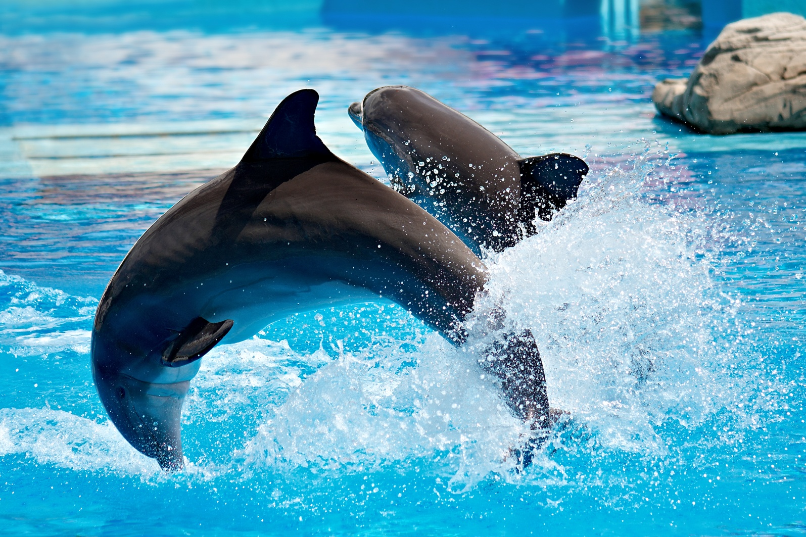
DOLPHIN
ALEXIA

Slide 2
Dolphins are graceful marine animals.

Slide 3
Dolphins travel in groups

Slide 4
There blubber helps them dive, leap.

Slide 5
The baby stays with their mom.

Slide 6
When the mom is hurt them to Sea World.

