Slide 1
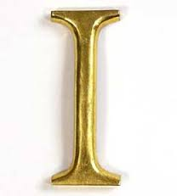
Boxing
By Dominick

Slide 2
Who started it
cavemen

Slide 3
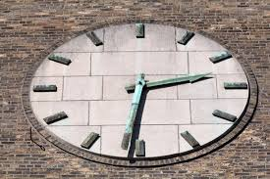
Date started
1684 for

Slide 4
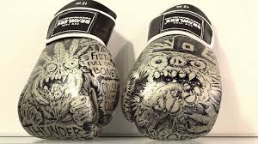
Equipment needed
Head gear, fist wrap

Slide 5
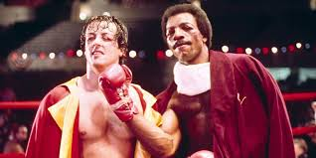
Number of rounds
9 to 12 rounds

Slide 6
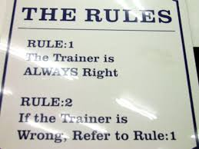
rules
Go to one person is knocked or tko “technical knock out” and referee decides who wins

Slide 7
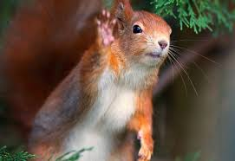
Good riddens

