Slide 1
Sweden
Drew Ryan Harbur

Slide 2
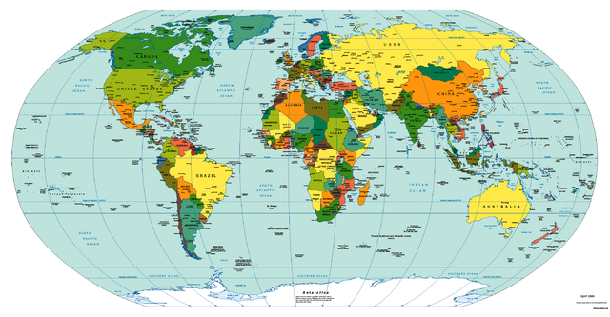
Sweden on the world map

Slide 3
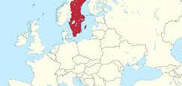
Sweden up close

Slide 4
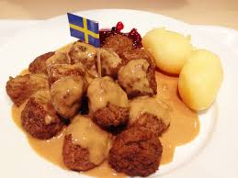
Sweden’s national food is meatballs.

Slide 5
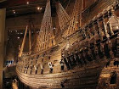
Sweden landmarks
Vasa Stockholm palace scansion and the gala Stan

Slide 6
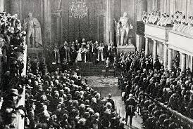
People
Benny Anderson, Britt Elkland

Slide 7
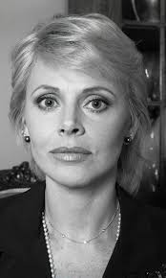
Britt Elkland
Was an actress and singer in Sweden.

Slide 8
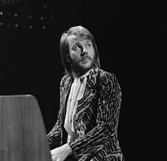
Benny Anderson
Played piano in a numerous amount of musical
groups. He was a composer and a co-composer to
an orcastra.

Slide 9
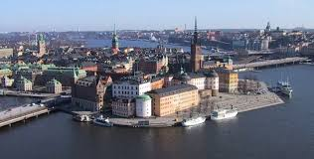
city
Capital city: Stockholm

Slide 10
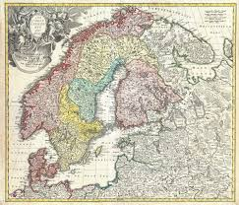
Population: 9,723,809

Slide 11
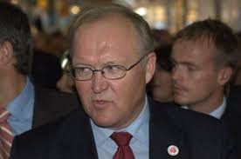
Current leader
Stefan liven

Slide 12
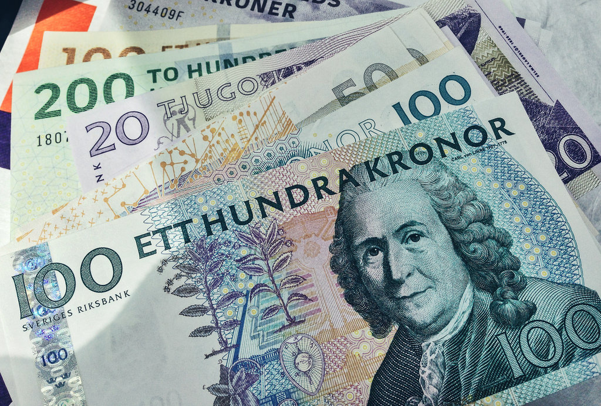
Currency
Swedish krona

Slide 13
Is the currency the same as america
Swedens currency: kronas
Americas currency: dollar
same
no

Slide 14
Languages hi in Swedish
Swedish, Yiddish, finish, Romani
halla

Slide 15
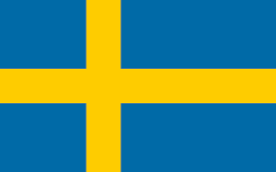
flag

