Slide 1
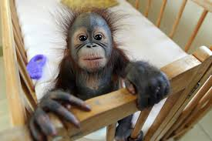
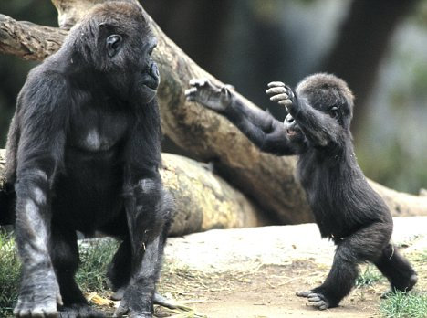
Apes
Designed by: Emalee

Slide 2
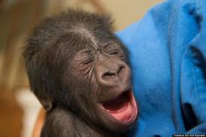
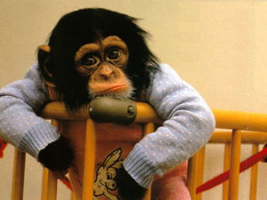
Apes yawn like humans and even shed tears.

Slide 3
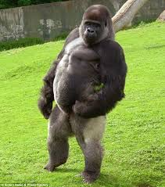
Apes can walk on two legs but they don’t feel comfortable.

Slide 4
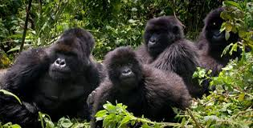
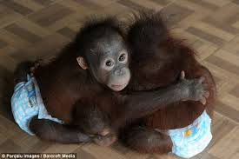
Apes are monkeys that resemble humans.

Slide 5
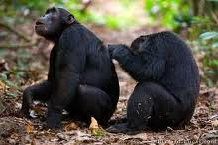
They pick through each others hair to remove any dirt, burs, or insects.

Slide 6
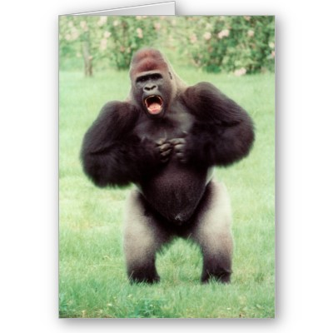
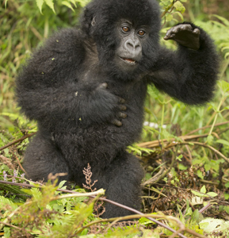
Apes beat their chest as a threat or a sign of curiosity.

Slide 7
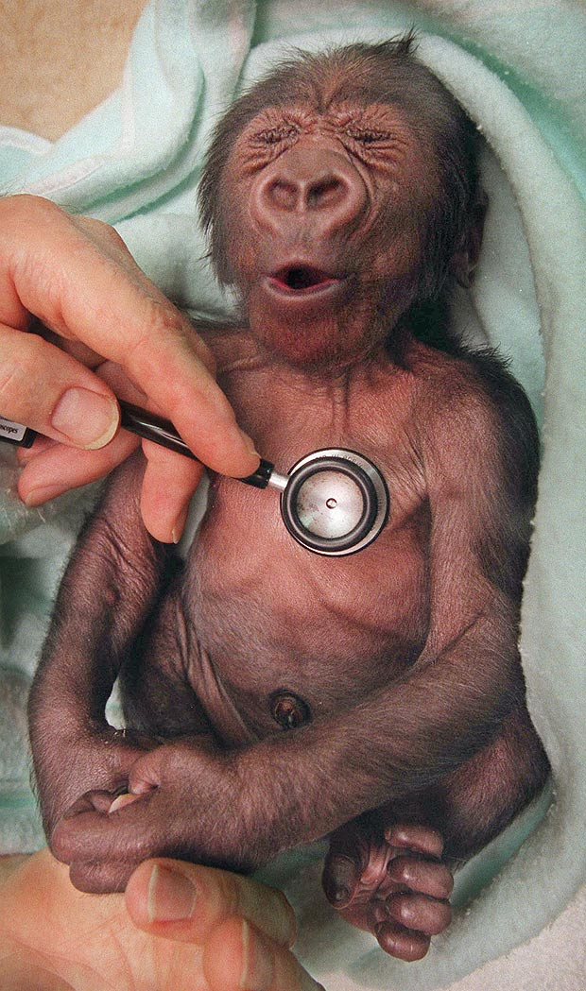
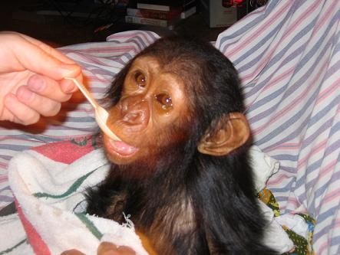
Apes can get human dieses.

Slide 8
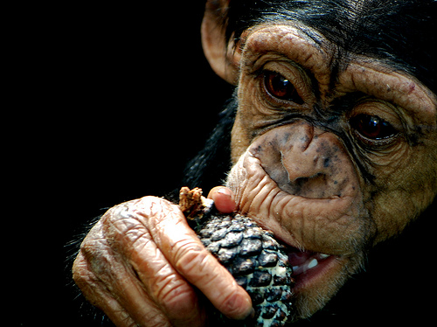
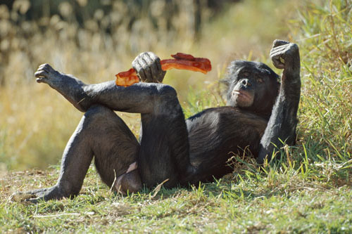
Apes only eat plants in the wild , such as fruit and parts of plants.

Slide 9
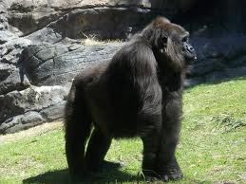
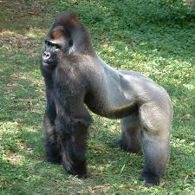
Apes can grow up to 5 ½ feet tall.

Slide 10
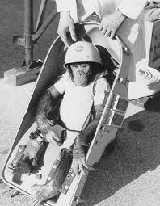
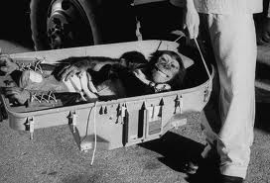
In 1961 the first ape went to space, his name was ham.

Slide 11
Resources
Wexo, John. "Apes." Zoobooks Jan. 2012: 16. Print.

