Slide 1
RUSSIA
GARRETT

Slide 2
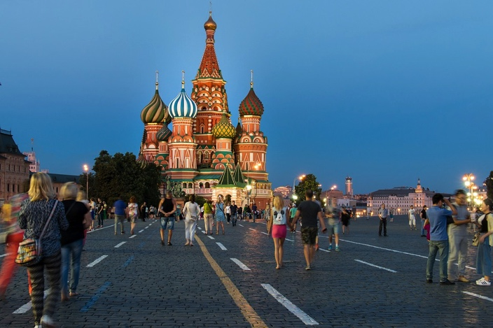
Capital city
Moscow

Slide 3
Language is Russian

Slide 4
Location on the map

Slide 5
Flag

Slide 6
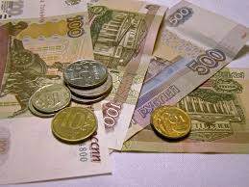
currency
144 million pounds

Slide 7
The national food is pelmeni

Slide 8
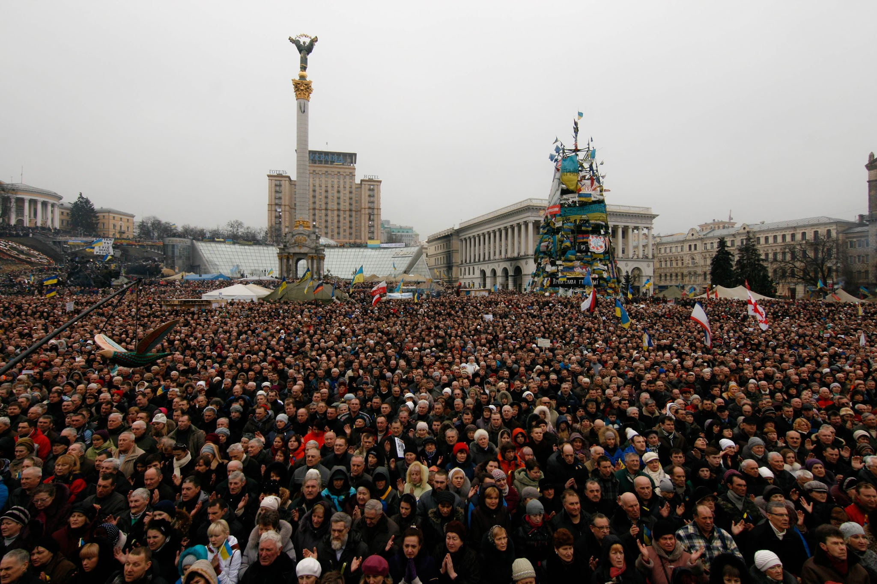
Population
144.3 million

Slide 9
Famous people
Anna kournikov]pro tennis player
Irina Shayk]model
Maria sharaova]tennis player
Osanna grevionk]singer
Regina spektor] singer

Slide 10
Anna kournikova

Slide 11
Irina shayk

Slide 12
Maria sharaova

Slide 13
Hi in Russian
ЗДРАВСТВУЙ

