Slide 1
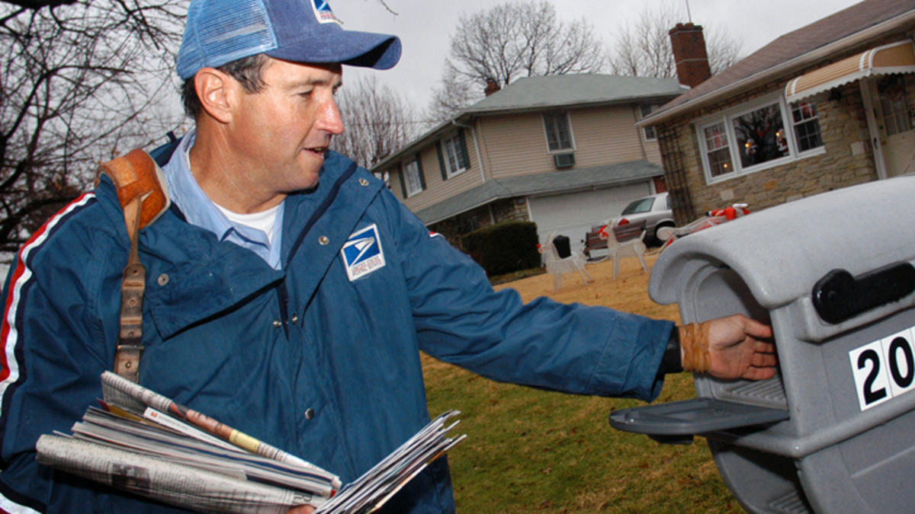
Mail carrier
Created by hunter

Slide 2
Work activity
Work with the public
Handle and move objects
Get information
Maintain records
Pick up out going mail

Slide 3
Physical demands
Use hands to handle
Sit for long periods
Stand for long periods of time
Bend and twist their body

Slide 4
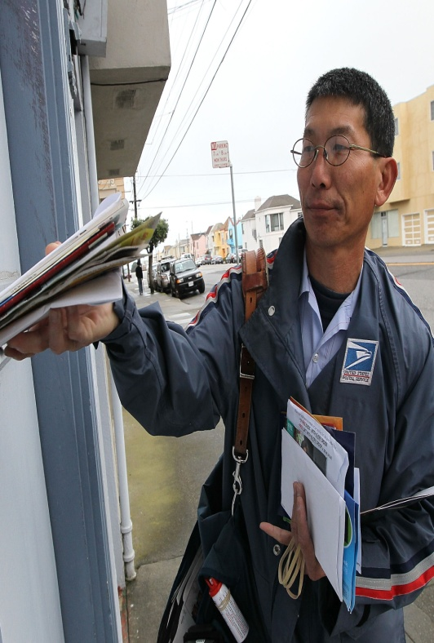
skills/abilities
Listen and ask questions
Read and under stand work materials
Express ideas clearly when speaking

Slide 5
Work settings
Many deal with angry people
Always wear uniform
Repeat same activities
may work Saturday
may work early in the morning

Slide 6
preparation
Costumers and costumer service
Public safety and security

Slide 7
Helpful school courses
Drivers ed
Physical ed
Actual work experience
Work based opportunity
fieldtrips

Slide 8
Nebraska colleges
UNK
CCC of Grand Island
CCC of Lincoln

Slide 9
wages
location | Pay period | 10% | median | 90%
Nebraska | annual | 40,860 | 53,440 | 56,500
central | annual | 40,860 | 42,810 | 56,360
North east | annual | 40,860 | 48,270 | 56,500

Slide 10
Why did you decide upon this career
It is easy to do and it is fun and there is good pay

