Slide 1
JAPAN
By:Lexi Robinson

Slide 2
population
127 million people
15 to 64 years old

Slide 3
continent

Slide 4
Famous leader

Slide 5
food

Slide 6
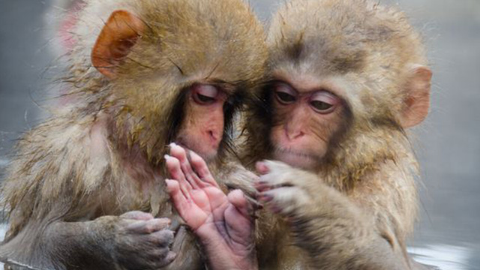
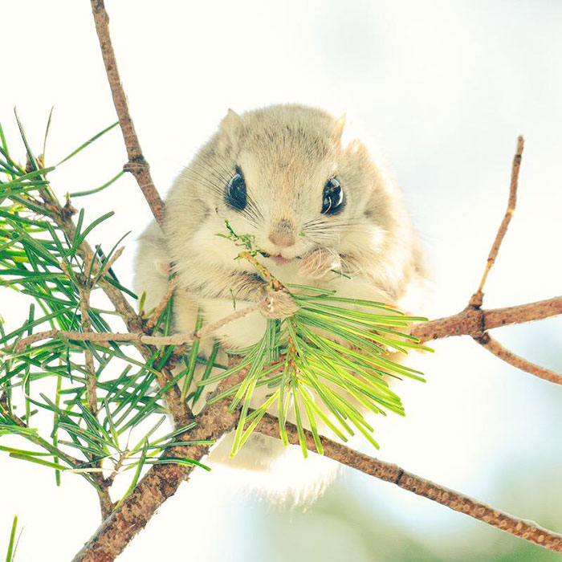
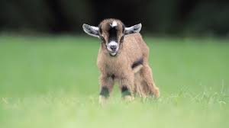
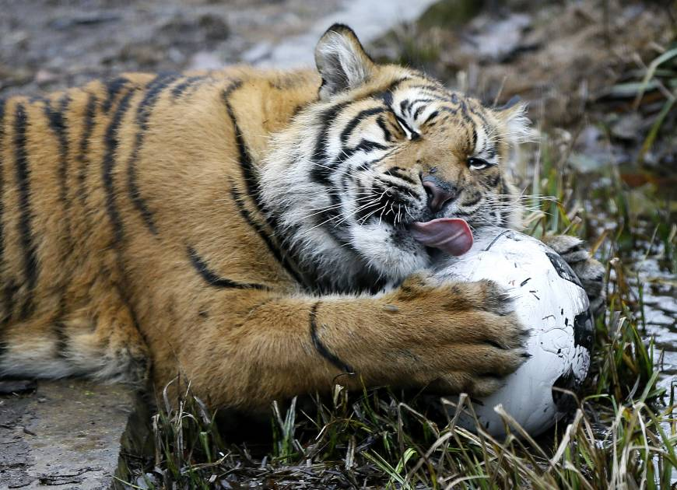
animals

Slide 7
clothing

