Slide 1
Velociraptor
Made by Jeremiah Shoemaker

Slide 2
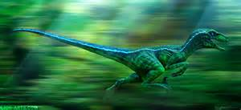
Velociraptor

Slide 3
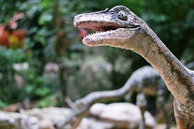
Velociraptors are amazing for 3 reasons.
How long it is
How tall they are
How they look

Slide 4
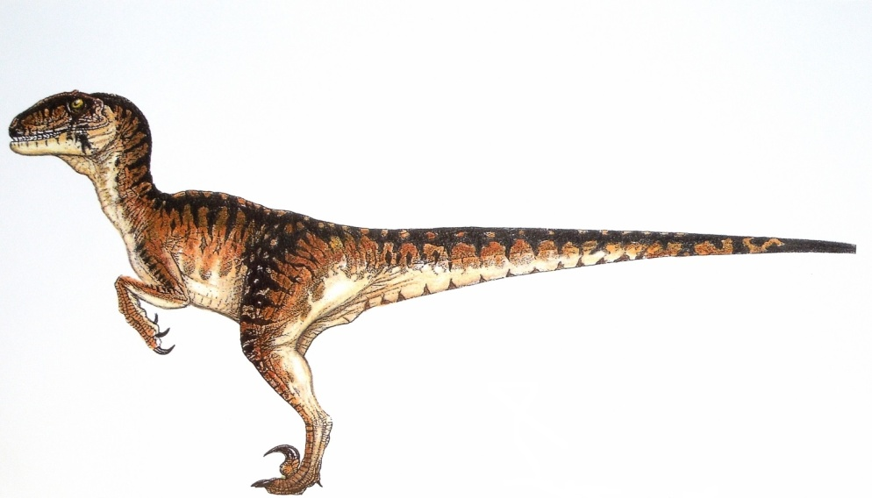
Velociraptors are amazing for how long they are.
1 They are 6 feet long.

Slide 5
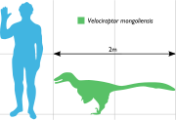
Velociraptors are amazing for how tall they are.
They are 3 feet tall.

Slide 6
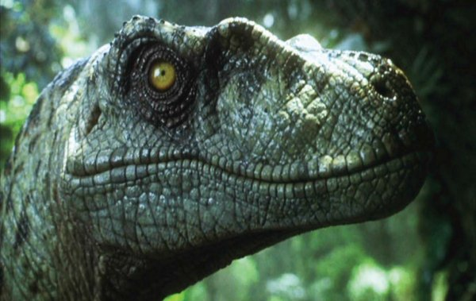
Velociraptors are amazing for what they look like.

Slide 7
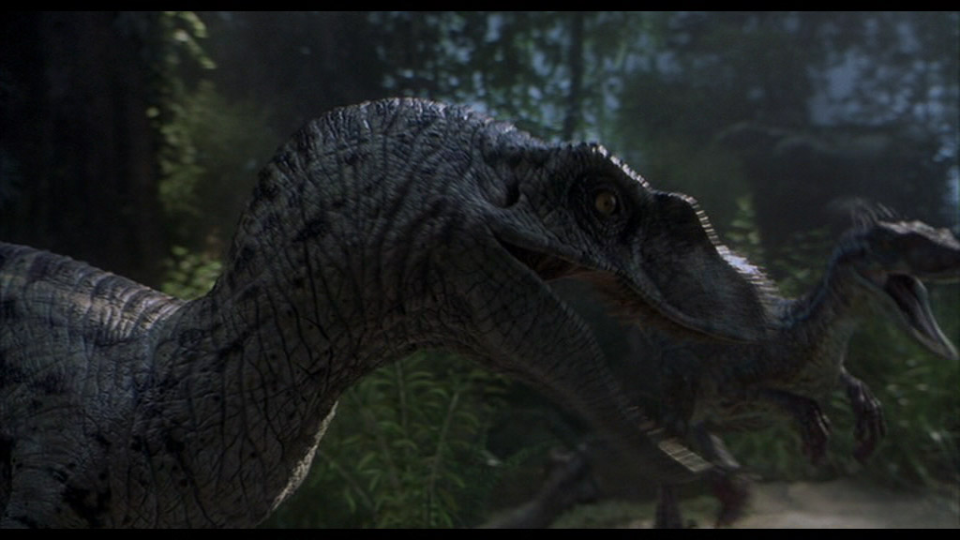
Velociraptor
They weigh 40 pounds.

Slide 8
About Velociraptors
They died 65 million years ago. They were found in Asia. They ate meat. Some had feathers. They were the size of a turkey.

Slide 9
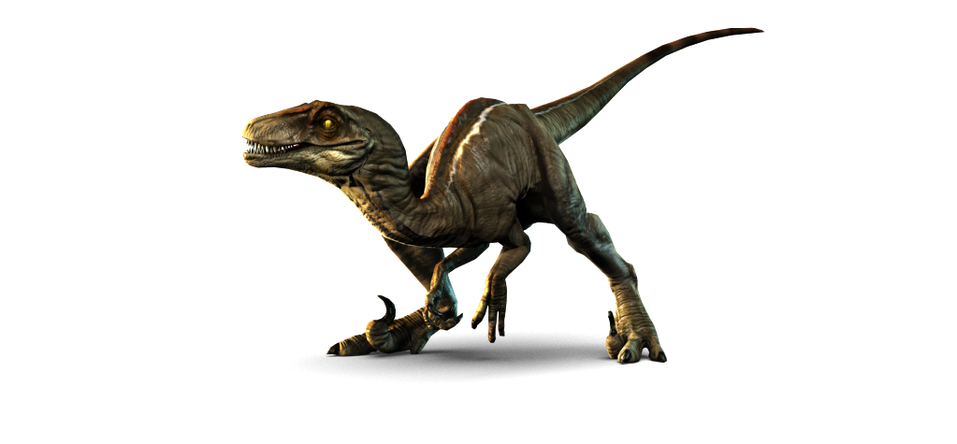
Velociraptor

