Slide 1
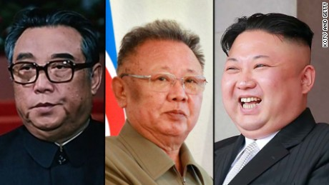
North Korea

Slide 2
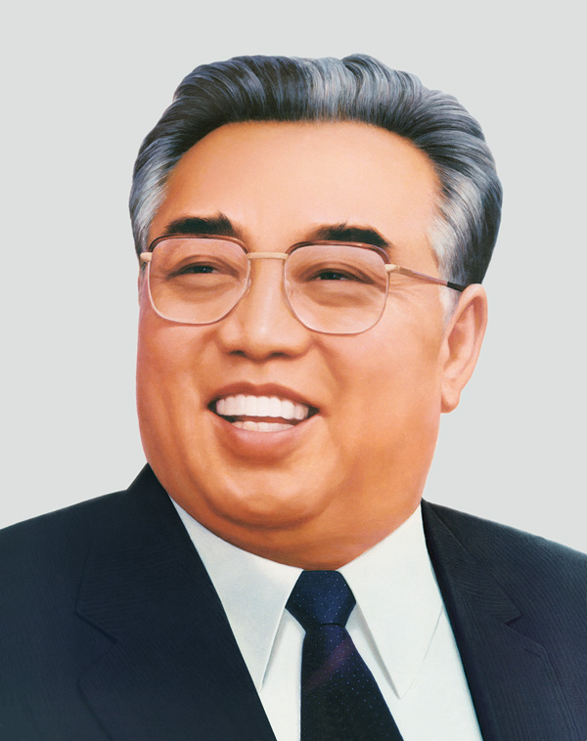
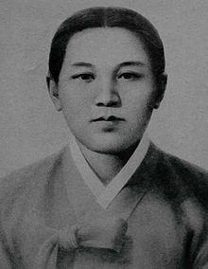
North Korea Holidays
Korean New Year
Kim Sung ll’s
Birthday
Kang Pon Sok’s
Birthday
Many More

Slide 3
North Korea Leaders
Their barber has a sense of humor

Slide 4
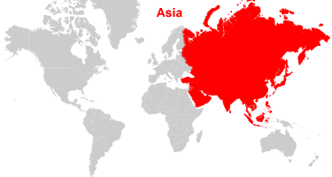
North Korea is part of
Asia

Slide 5
Map Of North Korea

Slide 6
Population
25.37 million

Slide 7
Major wars
North Korea is currently threatening to nuke America and or South Korea. But previous wars include the Vietnam war, World War – Two and The Korean War.

Slide 8
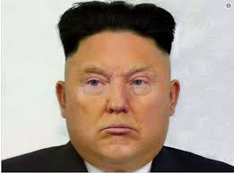
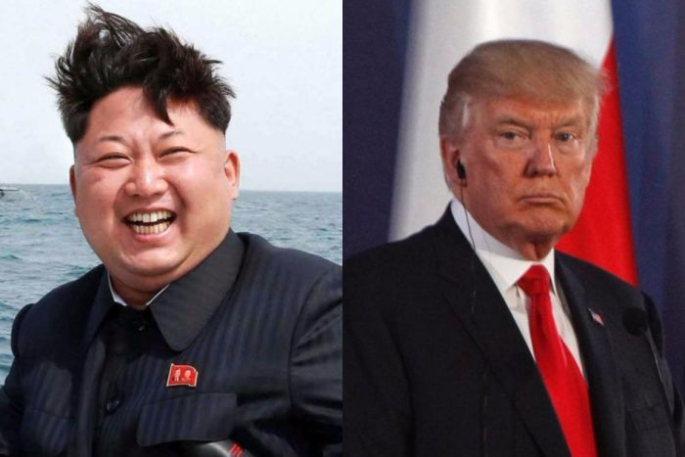
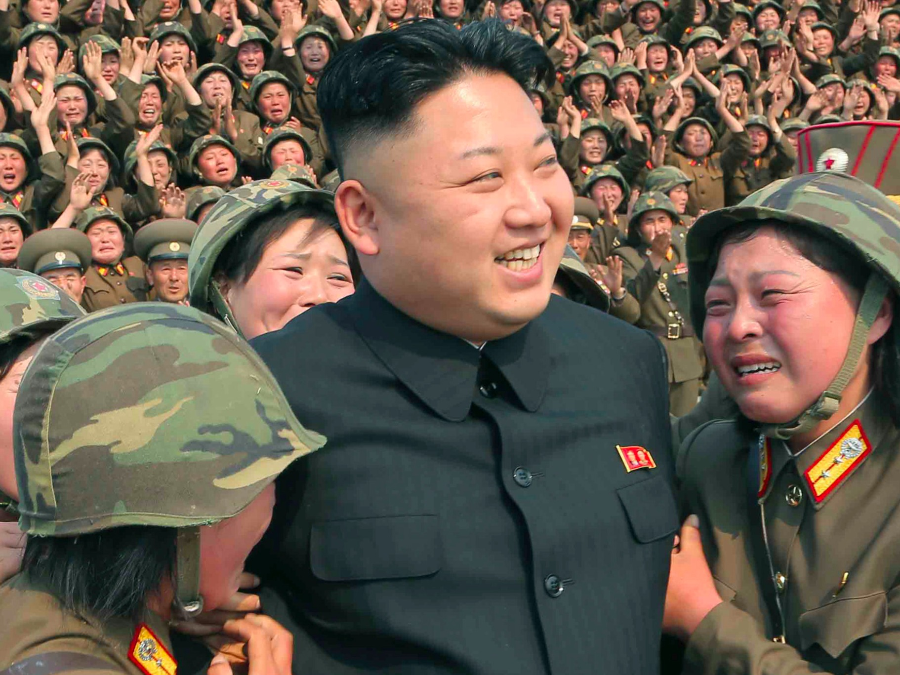
North Koreas current Government leader is Kim Jong Un

Slide 9
More pictures of Kim Jong Un II

Slide 10
Favorite foods In NORTH KOREA
Rice
Vegtables
Meat

Slide 11
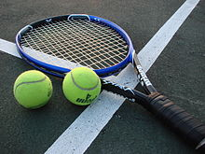
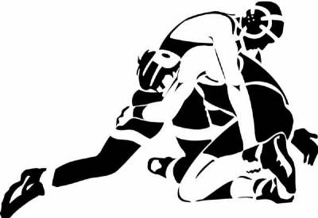
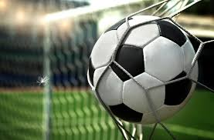
Common sports in North Korea
A common sport in North Korea is tennis.
You will also probably see people wrestling.
Soccer is popular too

Slide 12
North Korea flag

Slide 13
The End

