Slide 1
Zebras
Created by Kynadi Dallmann

Slide 2
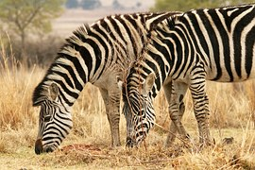
I love Zebras

Slide 3
Zebras are Amazing for 3 Reasons
It’s Speed
It’s stripes
Where they live

Slide 4
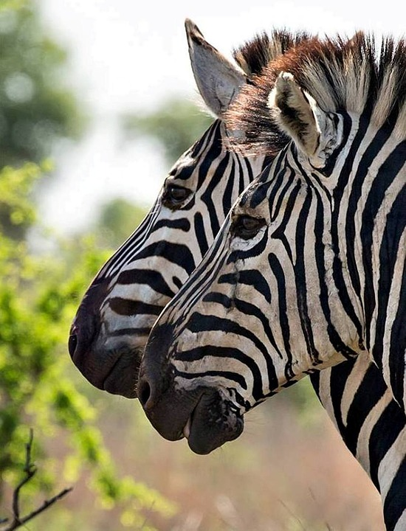
The Zebra is amazing for it’s Speed
They can run as 40 miles per hour

Slide 5
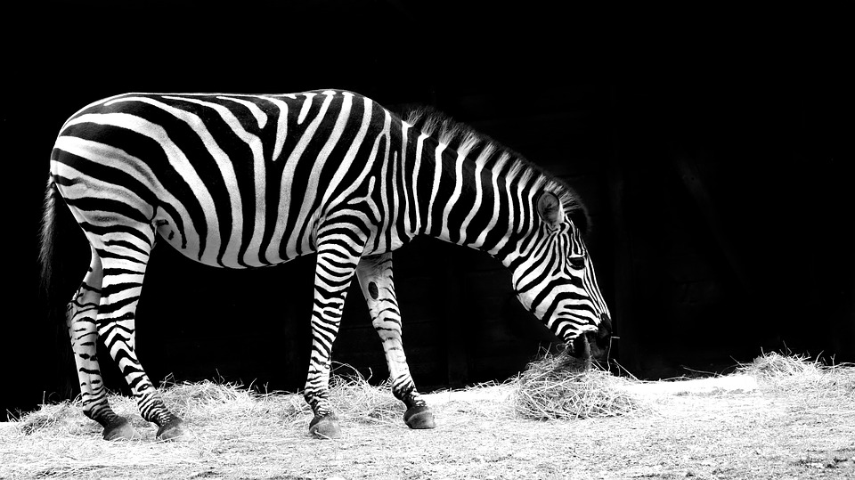
It’s stripes
A zebra can run as fast as 40 miles per hour

Slide 6
Where they live
They live in Eastern and Southern Africa

Slide 7
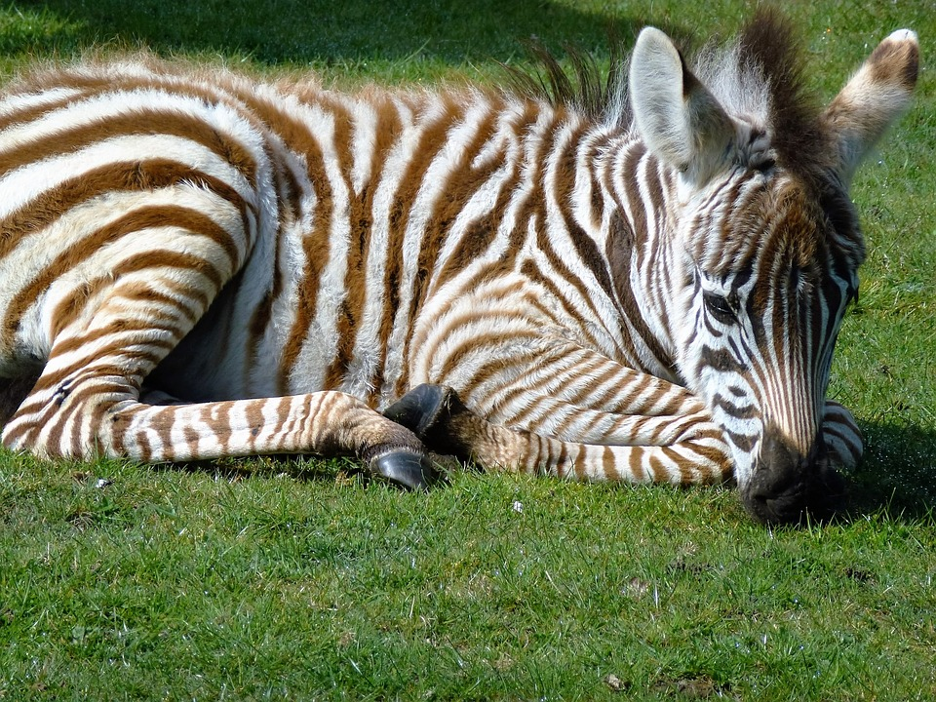
Thank you for watching

