Slide 1
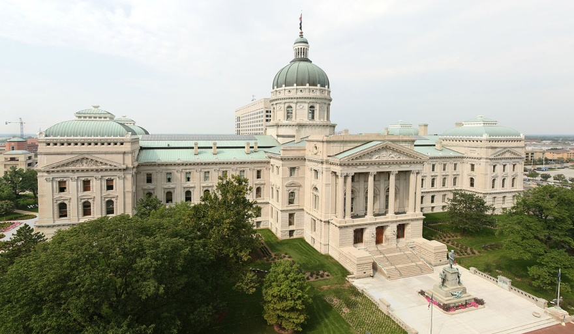
Indiana
lily

Slide 2
Indiana

Slide 3
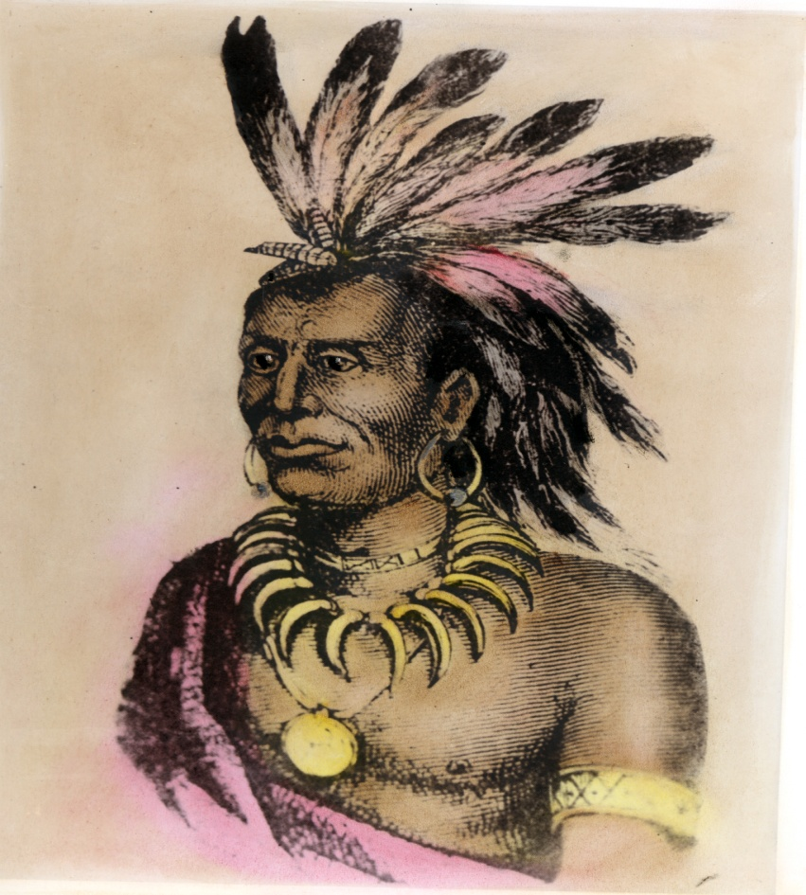
History
Chief Little Turtle was the leader of the Miami tribe in the 1790s. He raided Indiana farms and villages.

Slide 4
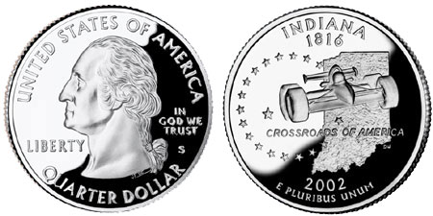
Things about Indiana
Indiana became a state in December 11, 1816.
It is also the 19 state in America .
Indianapolis is the capital of Indiana.
Indiana university

Slide 5
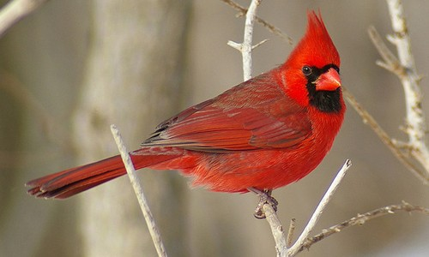
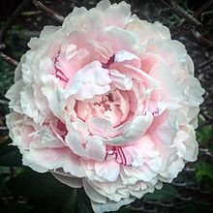
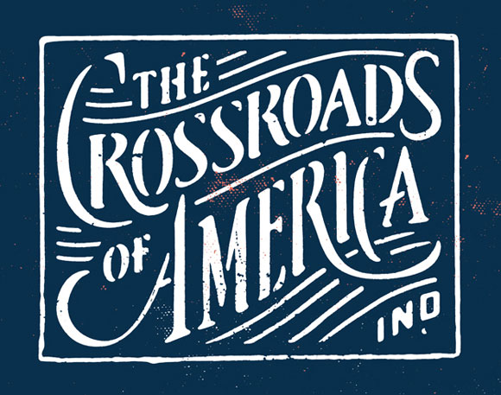
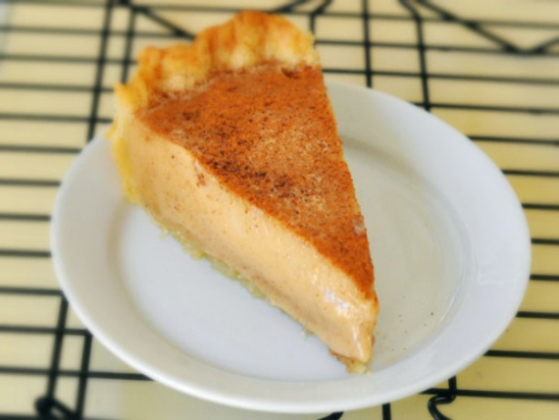
State Symbols
Cardinal
The crossroads of USA
Peony
Hoosier state
Sugar cream pie
Tulip tree

Slide 6
Sports teams
Indiana pacers
Indianapolis Colts

Slide 7
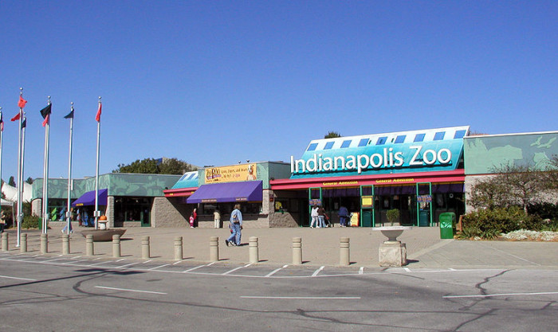
State attractions
Indianapolis zoo
Indianapolis dunes
Indianapolis beach bound walk
Indianapolis blue chip casino
Indianapolis turkey run state park

Slide 8
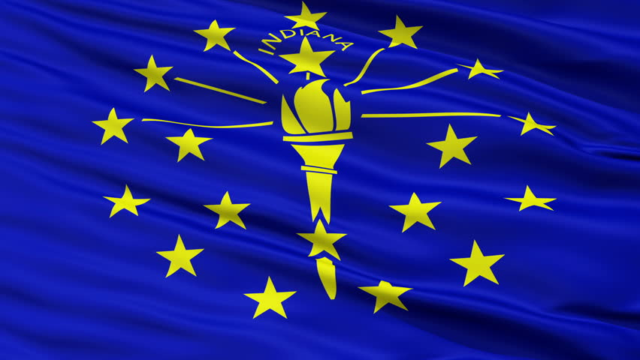
Major cities what they are known for
Indianapolis is the capital
Madison is known for historic homes
Hoosier several forests
Corydon was the first capital

Slide 9
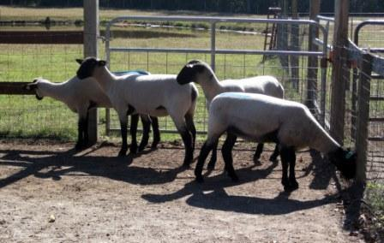
Natural resources
Cattle
Corn
Dairy
Hay
Clay
Oats
Sheep
Limestone
Coal

