Slide 1
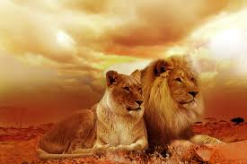
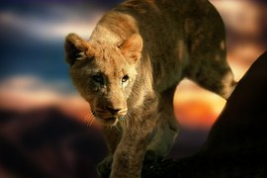
Lion
Morgan

Slide 2
Where Found
Africa, South of the Sahara; Indian

Slide 3
Habitat
Grass Land, and Forest

Slide 4
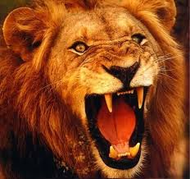
Predators
He has no Predators he is the King

Slide 5
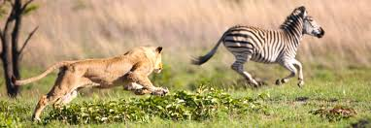
Food
Deer, Antelope, Zebra, and other hoofed animals

Slide 6
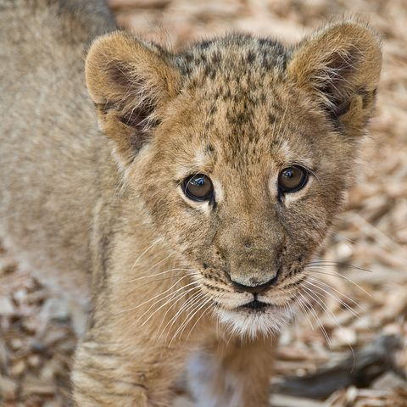
Lifespan
16 to 20 years

Slide 7
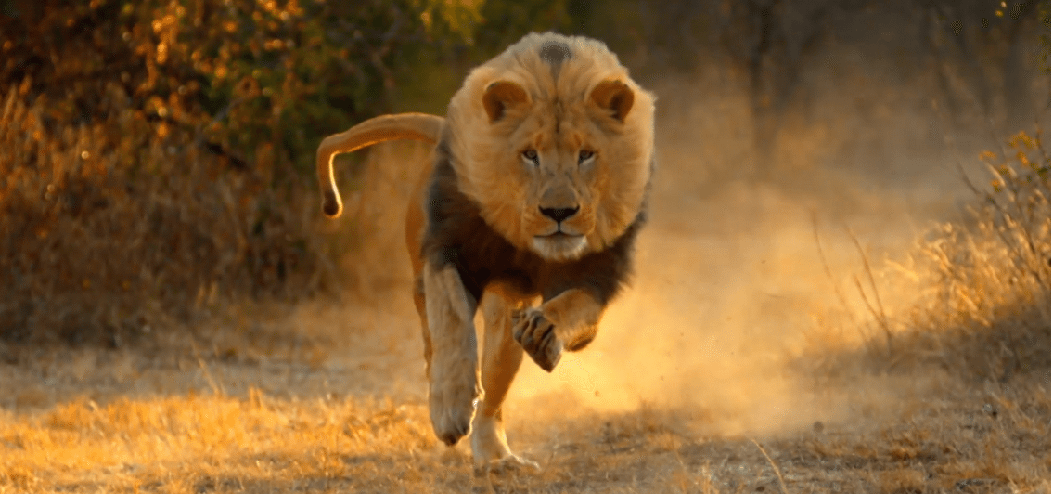
Weight
250 to 400 pounds ( 113 to 180 kilogram)

Slide 8
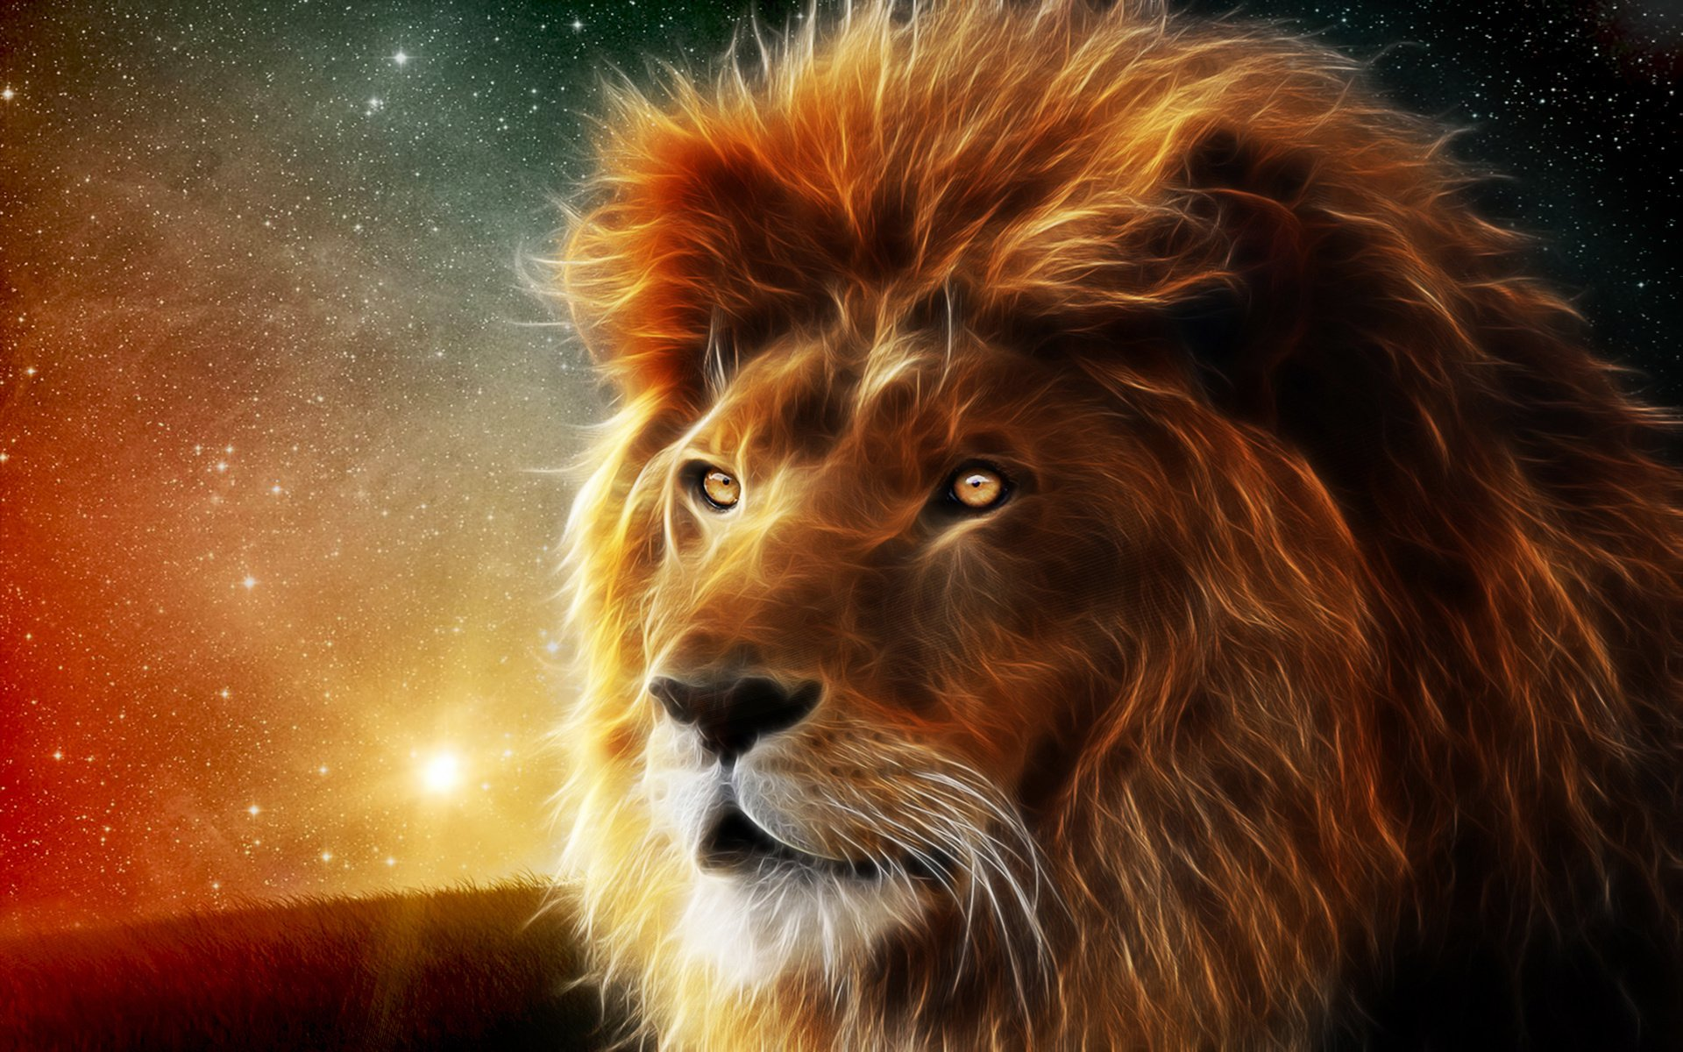
Length
9 feet( 2.7meters) long including the tail

Slide 9
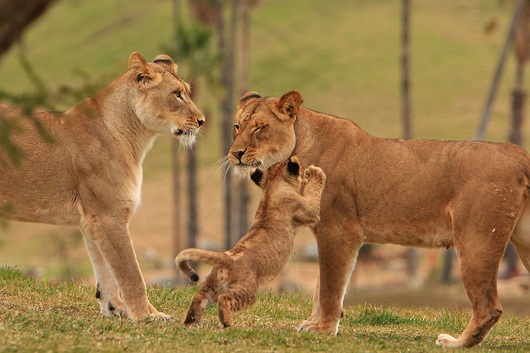
Height
3 to 4 feet(0.9 to1.2 meters) tall at the shoulder

Slide 10
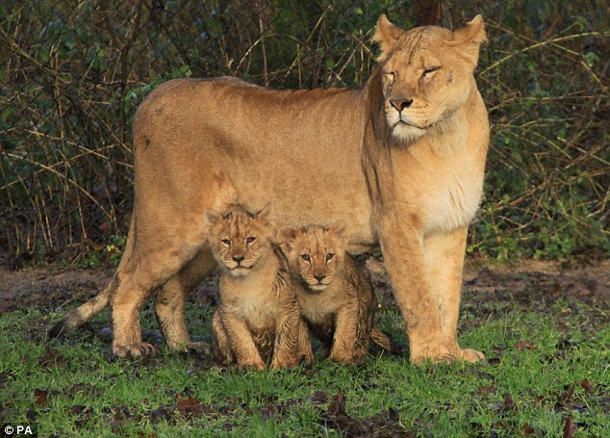
Number of Newborn
3 to 2 cubs

Slide 11
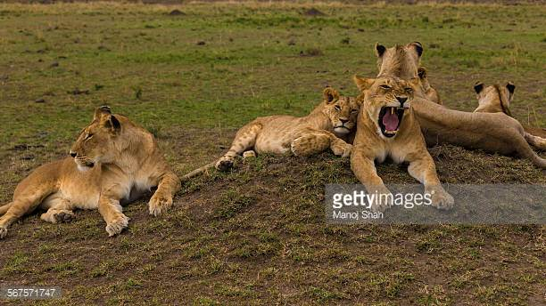
Name of Group
pride

Slide 12
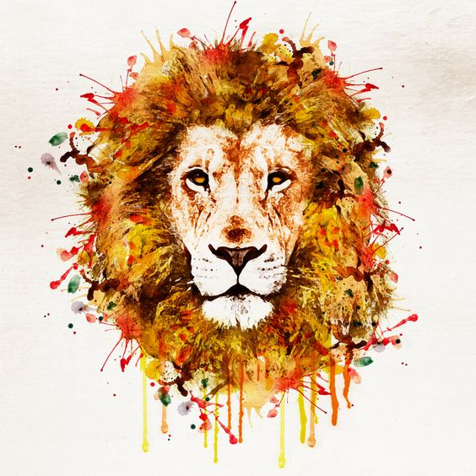
Body Temerature
Warm- blooded

Slide 13
Size of Group
Between 6 to 50 lions

Slide 14
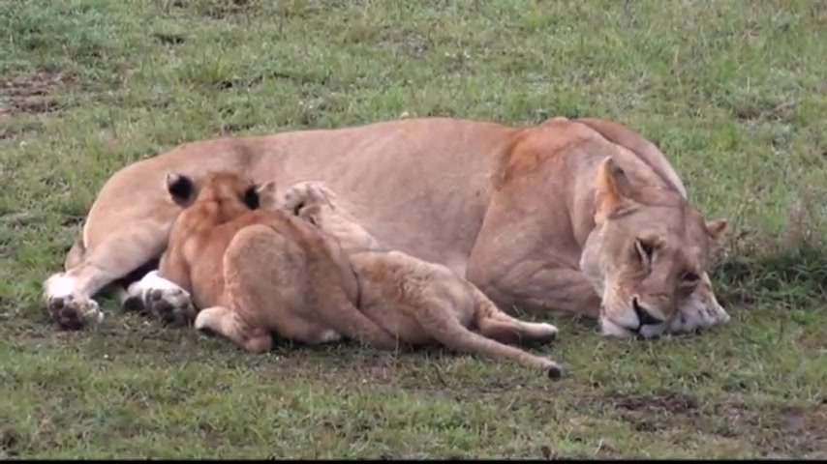
Type of Newborn
Live Birth

Slide 15
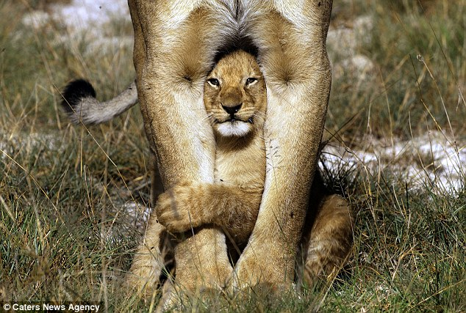
Conservation Status
vulnerable

Slide 16
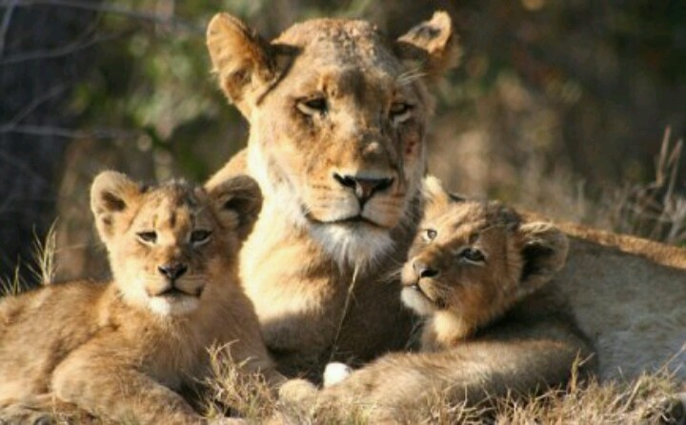
Interesting Fun Fact
When not in use, each claw on a lion with draws into a sheath in the paw. That helps the claws to stay sharp.

