Slide 1
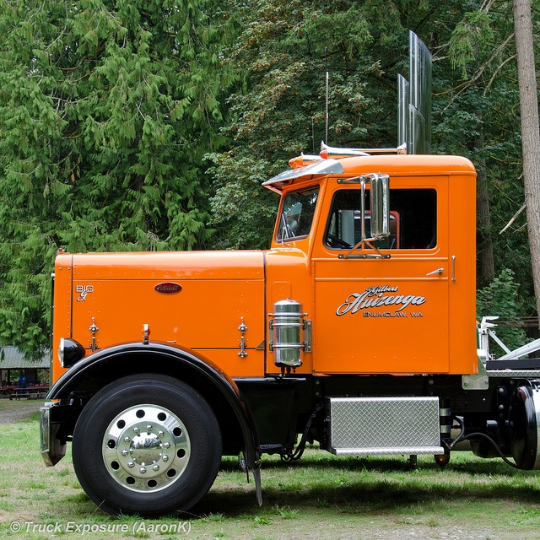
American semi trucks
BY, Preston L. Leigh

Slide 2
Kinds of semi truck
Peterbilts
It was founded in 1939
They are built in Denton, Texas
Kenworth
It was founded in 1923
There is a lot of dealer ships in Nebraska
Freightliner
It was founded in 1942
They where originally built in Salt lake city, Utah

Slide 3
Inside the cab
Dash
Sleeper

Slide 4
Semi truck facts
The maximum weight of a semi is 60 tons ( 54 tones )
There are trailers as long as a school bus

Slide 5
What is the weight limit for a semi
60 tones
30 pounds
100 tones

Slide 6
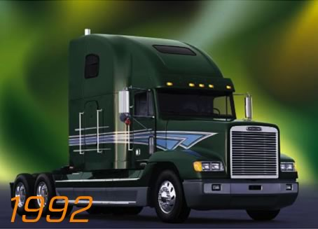
CORRECT
You won a NEW semi !

Slide 7
Wrong try again

Slide 8
Thanks for watching

