Slide 1
Robert Beatty
Rylee Gutzwiller

Slide 2
ROBERT BEATTY ROBERT BEATTY Y

Slide 3
BACK ROUND INFORMATION
He lives in the mountains of Asheville,North Carolina
He has a wife and three daughters
He likes history,nature,birds,horse back riding,and the wild life
,

Slide 4
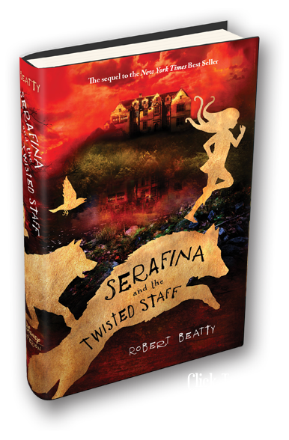
BOOKS he wrote

Slide 5
FIRST BOOK

Slide 6
ONE THAT I HAVE READ
Serifna and the Black cloak and Serifina and the twisted staff

