Slide 1
Hurricane
BY: Simon

Slide 2
How they form.
They form over the ocean.
They produce lots of rain that causes flooding.
They form in waters 82 degrees and above.

Slide 3
Where they are at.
In the ocean.
Then they move to land.
Hurricanes are bad.
They form in warm waters.

Slide 4
How big are they.
They are more than 160 miles wide.
They can cover whole states.

Slide 5
How strong are they.
The strongest one ever had winds 200mph.
The stronger ones have winds 130mph.
The weakest ones have winds 74mph.

Slide 6
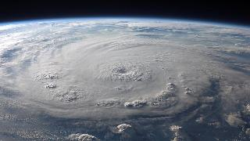
How big are they?
Are they 12 miles wide?
Are they 40 miles wide?
Are they 200 miles wide?
Are they 10,000 miles wide?

Slide 7
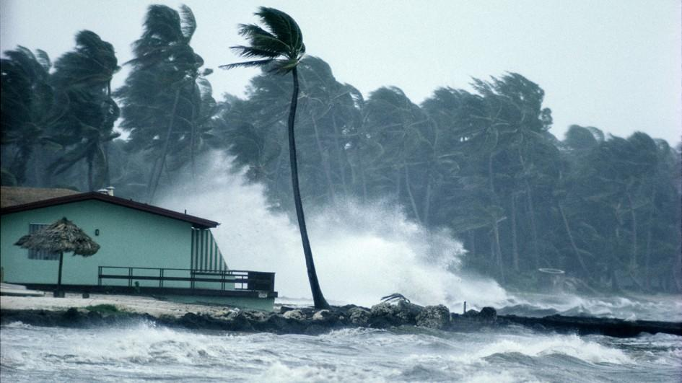
You got it right

Slide 8
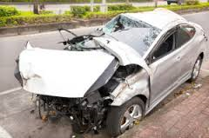
YOUR WRONG!!!!!!!!!
YOU FAILURE

Slide 9
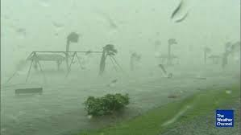
How strong are their winds?
Are their winds 12mph?
Are their winds 10,000mph?
Are their winds 74mph or
More?
Are their winds 400mph or more?

Slide 10
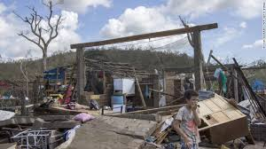
YOU ARE WRONG YOU BIG FAIL

Slide 11
You are right you old person.

Slide 12
THE END!! Thanks for watching!!

