Slide 1
Swine jobs in Nebraska
For Janet Rippe
From your friend Kadyn Schmidt

Slide 2
A swine job I found was
Leadership opportunities at pillen family farm

Slide 3
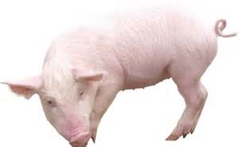
Another one I found is on
Valentine livestock .com
It is in sand hill ne
It is a job that you get to work with swine and hogs

Slide 4
Red willow county is 37 in swine production
Buffalo county is 54 in swine production
Nebraska is 6 in swine production in the us
Iowa is the 1st in swine production in the us

