Slide 1
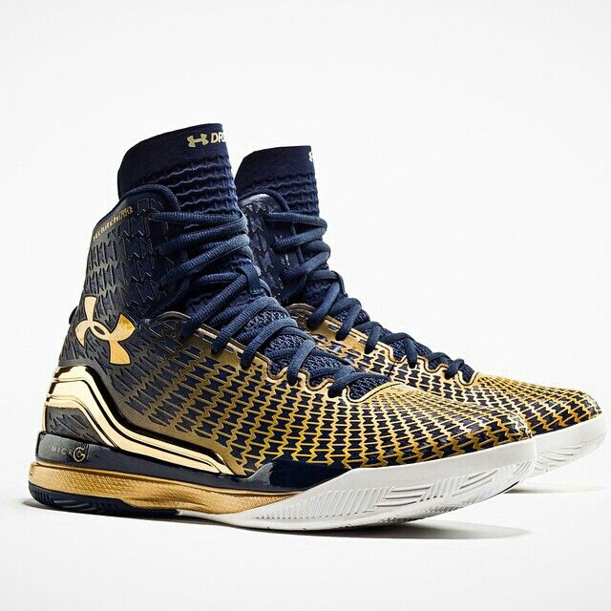
tj
basketball

Slide 2
HISTORY
The first game was in November 1, 1946
Basketball originated in 1891
James Vaism was a teacher

Slide 3
Kevin Dunant
He likes to play video games
And his favorite food is crab legs
His nick name is k-Smoove

Slide 4
Basketball basics
There is the NCAA and the NBA
THERE is offense and defense
Hoop 10 feet 3 meters

Slide 5
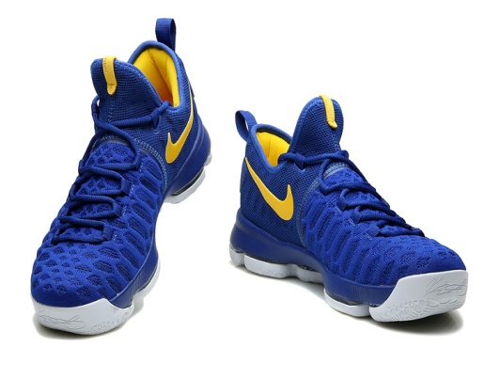
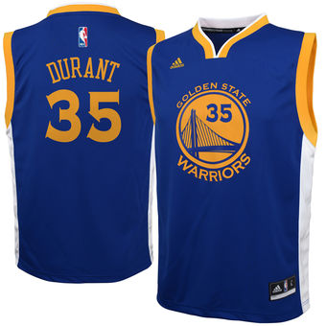
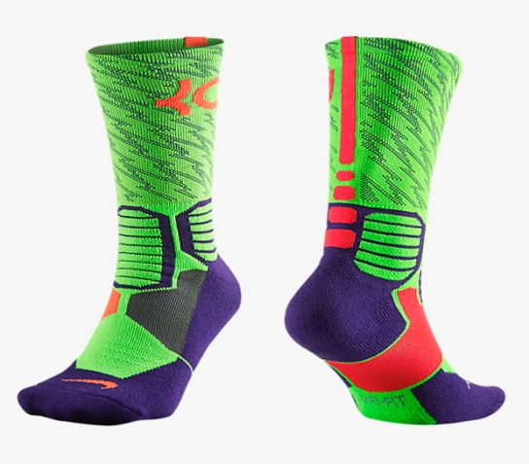
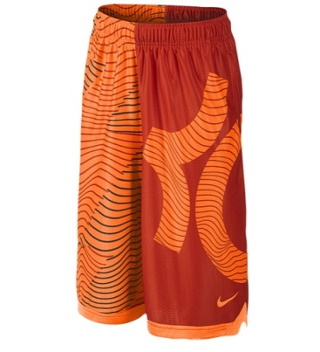
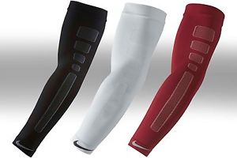
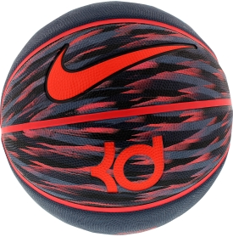
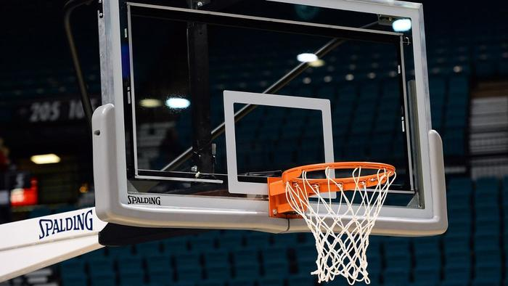
equipment

Slide 6
WHAT WAS THE FIRST NBA TEAM
UTAH JAZZ
LAKERS
COLTS
BULLS

Slide 7
CORRECT

Slide 8
WRONG

Slide 9
THE END

