Slide 1
Video Game Designer
Tranessa Hasbrouck

Slide 2
Work Activities
Adjust game play experience to making sure the product is successful with public
Main train in design and documentation
Create and manage production
Guide and participate in design
Mack screen shots ,game play ,and flow charts

Slide 3
Physical Demands
You have to sit for a long time
Repeat the same movement
Adjust machine controls
Under stand other people

Slide 4
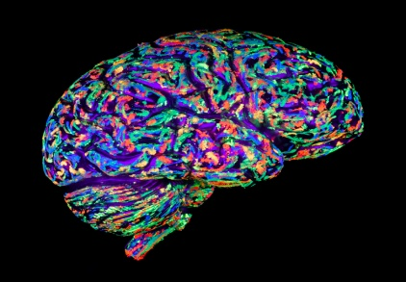
Skills and Abilities
Wright computer programs
Nature of problems
Listen to others
Ask questions

Slide 5
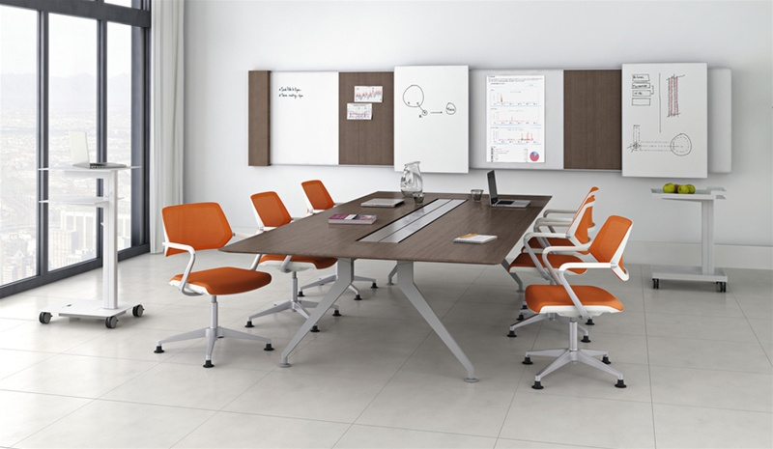
Work setting
Work a set schedule
Work in a competitive
Share office space with others
Often meet strict deadlines

Slide 6
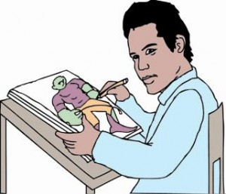
Out look
Nebraska
4,020 Annual openings
_{18 annual openings}
U.S.A

Slide 7
Knowledge
Knowledge of computers and software
Know the rules and numbers
Know algebra, geometry, and statistics
Knowledge of the English language

Slide 8
Preparation
A collage degree
_{Bachelor’s degree}
Degree in journalism
Degree in English

Slide 9
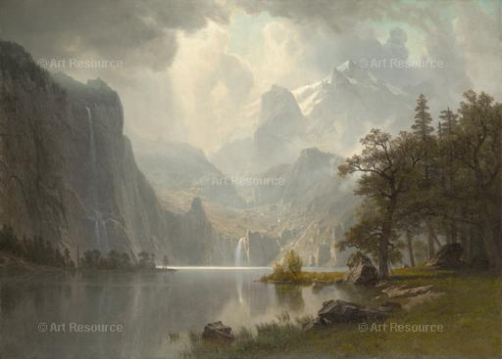
Helpful high school courses
Art
Computer programs
Creative writing
Draw and painting
Graph designs

Slide 10
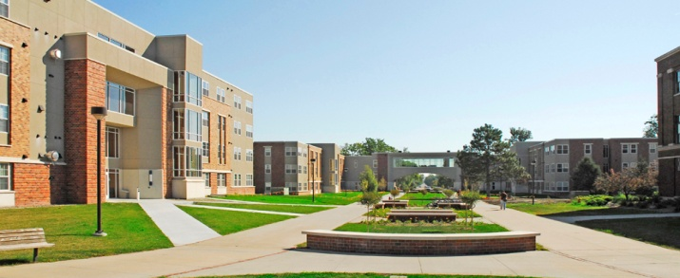
Nebraska collage/ school
Develop computers
Develop websites
Animation

Slide 11
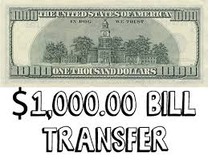
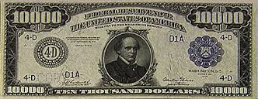
Wages
Location | Pay Period | 10% | Median | 90%
U.S.A | Yearly | $45,000 | $82,390 | $100,000
Nebraska | Yearly | $70,000 | $75,690 | $90,000
Idaho | Yearly | $73,000 | $87,440 | $100,910

Slide 12
Why did I decide upon this career?
I decided this career because this job fits my artistic ability!

