Slide 1
World War 2
By Trent Watkins

Slide 2
Countries in the wars ww2
USA had the attack on Pearl Harbor
U.K
had the Battle of Britain
USSR
Had the Battle of Stalingrad

Slide 3
Countries in War (part to 2 ww2)
France
Helped on D-Day
China
Battled Japan
Poland
Got Blitzkrieg

Slide 4
Countries in war part 3
Canada
Whet to war when in 1939
Italy
Joined Germany
Japan
Attacked China

Slide 5
Countries in the war part 4
Germany
Attacked Poland in the Blitzkrieg
Hungary
Helped Germany in the war
Finland
Got attacked by USSR

Slide 6
Allied guns
M1 Carbine took 15 bullets
Thompson submachine gun
M1 Garand took 8 bullets

Slide 7
Axis guns
Gewehr 98 Rifle took 5 bullets
Mg 42 took to 200 bullets
Stg 44 first assault rifle

Slide 8
Tanks
M1 Sherman
tank
Tiger tank strongest tank in ww2
T-34 tank

Slide 9
How it started
Germany attacked Poland
Got attacked at Pearl Harbor
U.K and France declare war on Germany

Slide 10
What country was attacked first by Germany?
Poland
France
Finland
Denmark

Slide 11
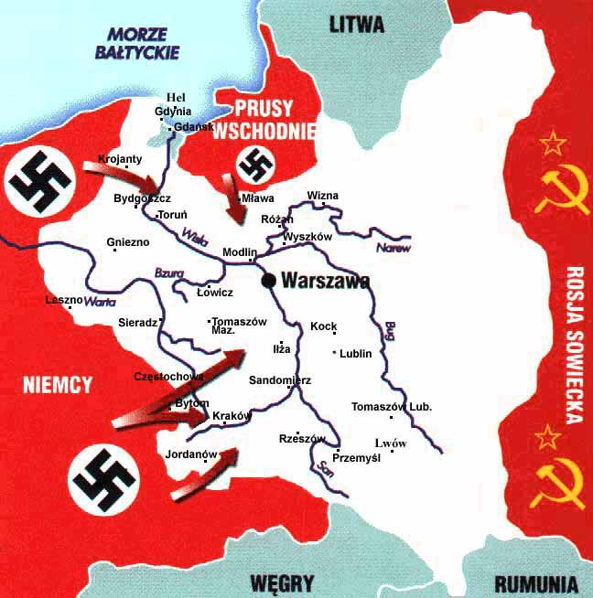
Correct

Slide 12
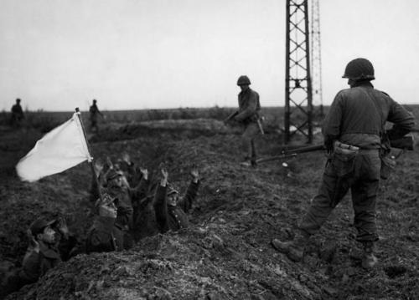
Wrong

Slide 13
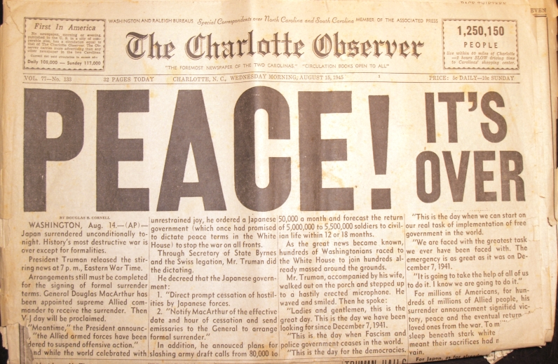
The end of the war

