Slide 1
Trent Reedy
By Joel

Slide 2
Trent Reedy

Slide 3
He was born in Dysart Iowa
He was in the National Guard
He went to war in Afghanistan

Slide 4
He has a daughter
He has a wife
He wants a secret place to right

Slide 5
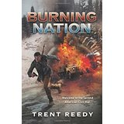
The books Trent Reedy wrote

Slide 6
Zilika was a Taliban person she lives in Afghanistan she was driven from her village.She had a clef plate.
Trent ready and his troop help her buy fixing and helping her.

