Slide 1
Vulture
Lola

Slide 2
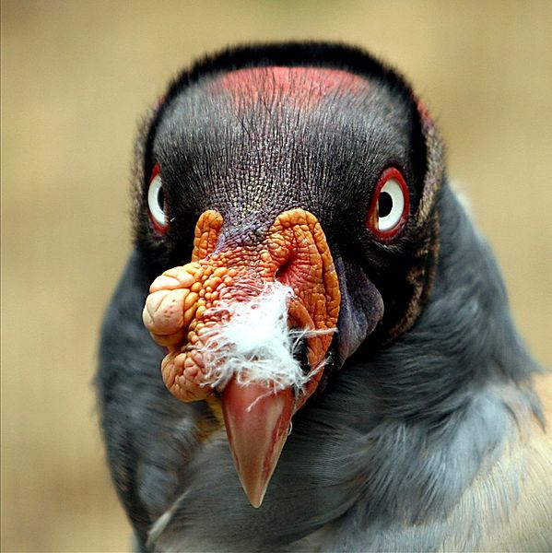
Weight
Six to ten pounds

Slide 3
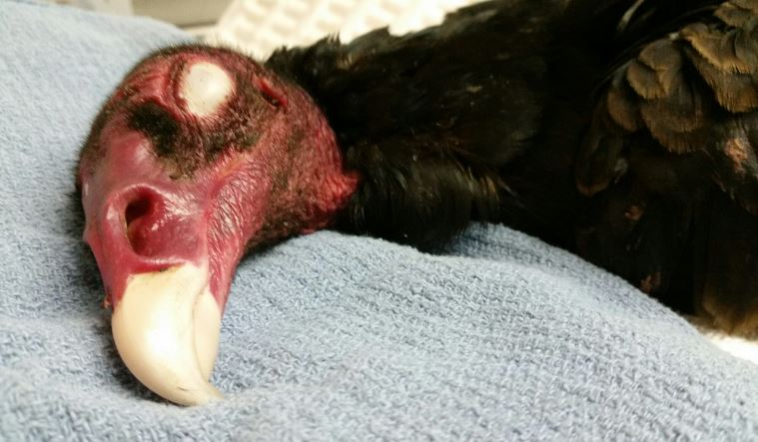
Life Span
Thirty years

Slide 4
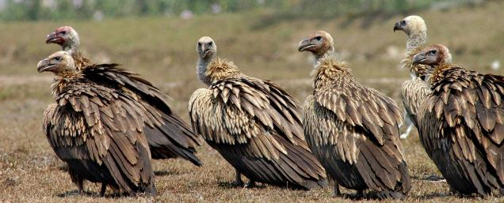
Size of Group
Usaully solitary ,but sometimes gathers in groups of ten vulture

Slide 5
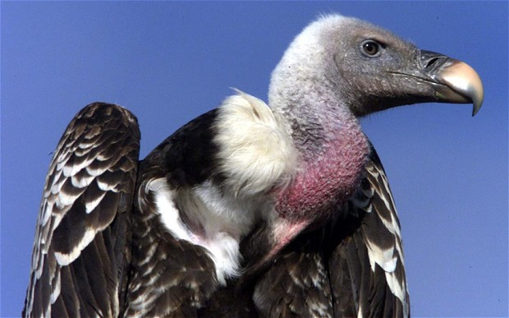
Name of young
Chick

Slide 6
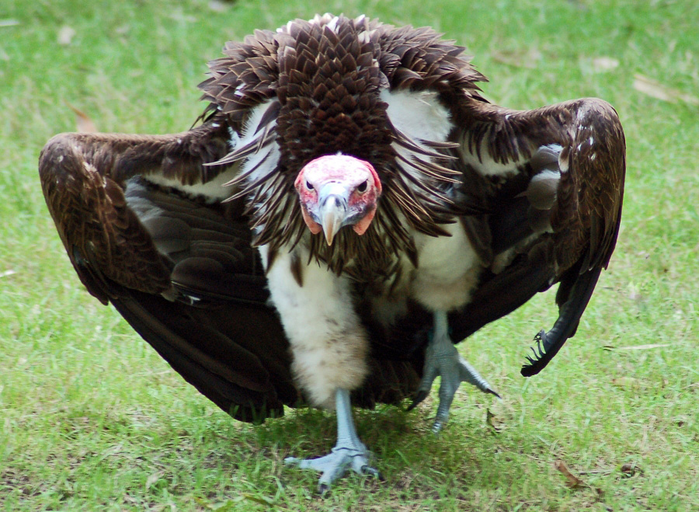
Name of group
Venue

Slide 7
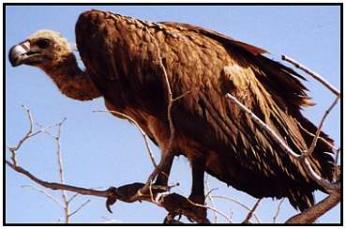
Height
Two and half feet tall (76cm)

Slide 8
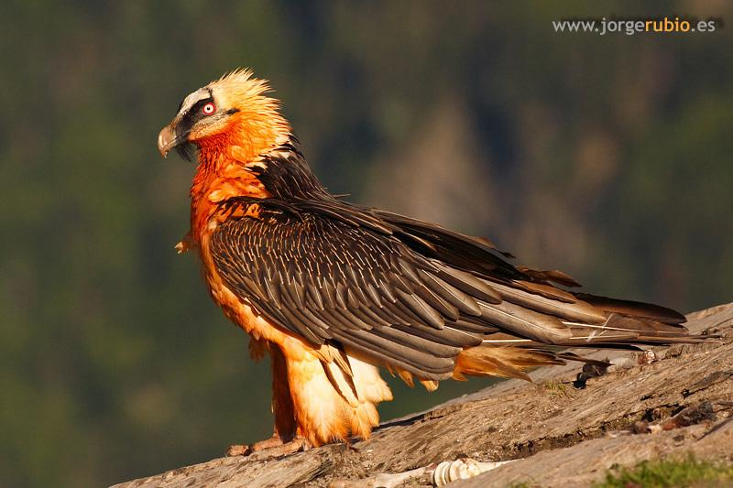
Length
Twenty seven to thirty two inches long

Slide 9
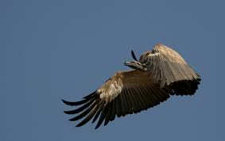
Found in
South and North America

Slide 10
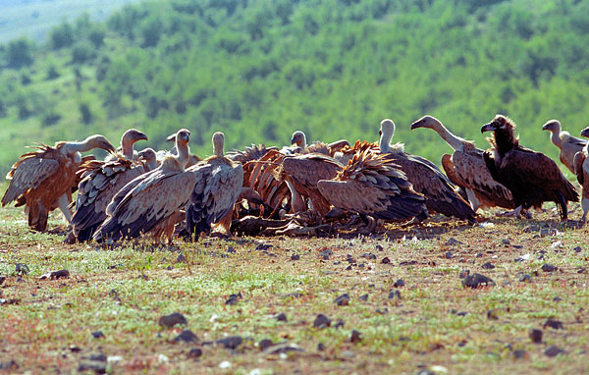
Habitat
Forests and Grassland

Slide 11
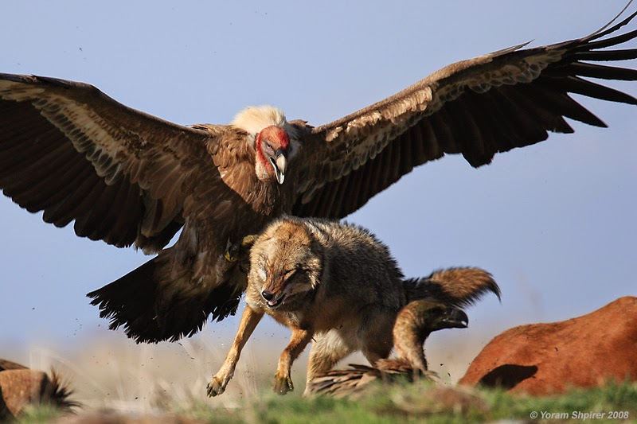
Predators
Large snakes and jaguars

Slide 12
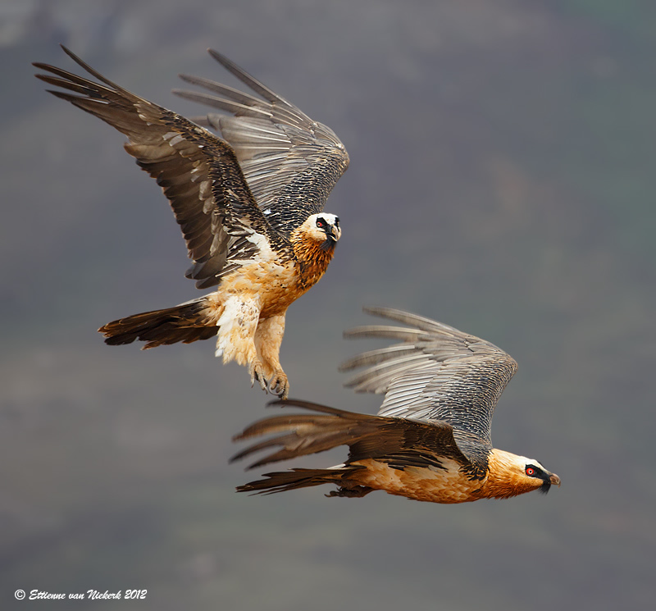
Number of newborn
One

Slide 13
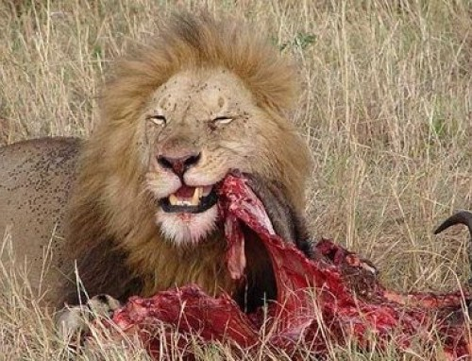
Diet type
Carnivore

Slide 14
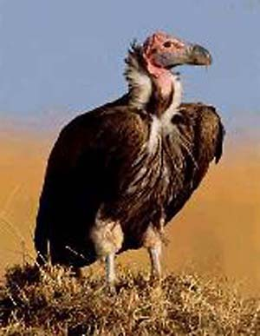
Fun Fact
Vultures have excellent eyesight.They can see dead animals from more than four miles away

Slide 15
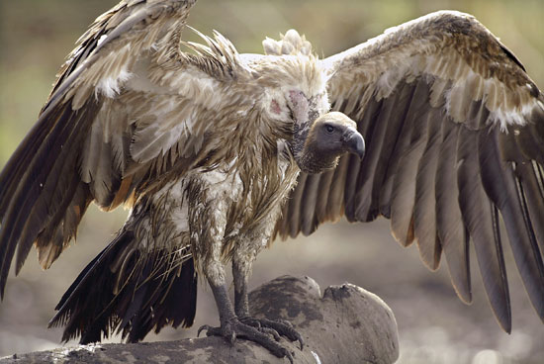
Sample foods
Dead and decaying animals flesh

Slide 16
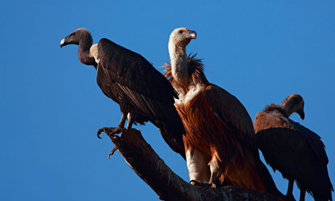
Body temp
Warm blooded

Slide 17
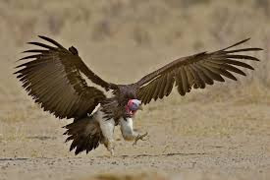
Species or Breed
King Vulture

Slide 18
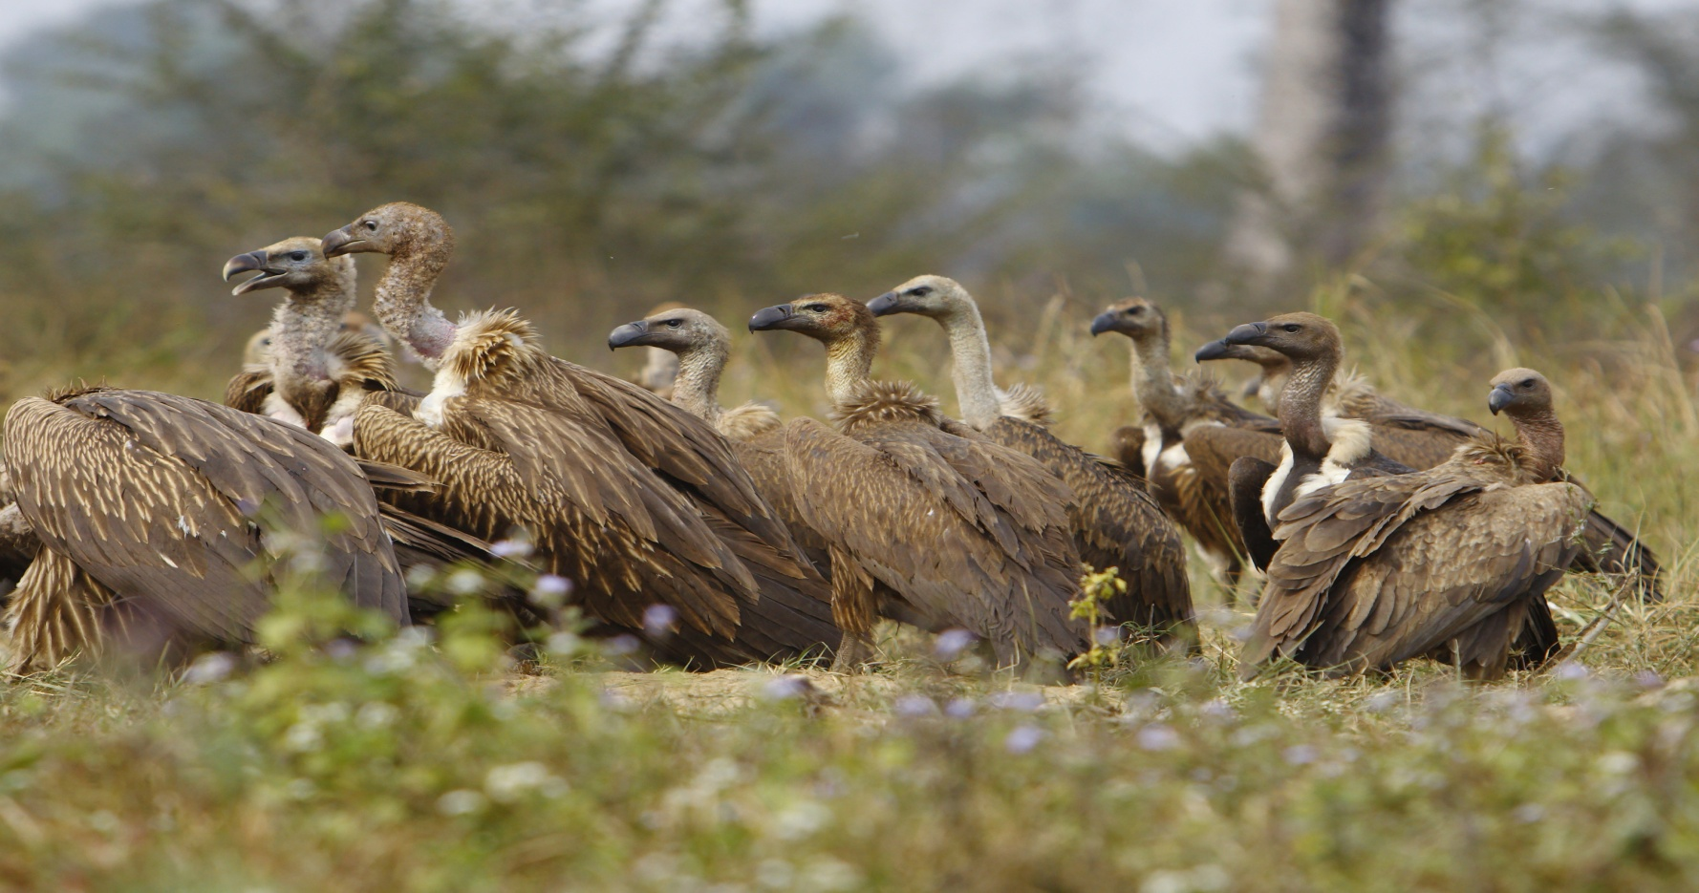
Scientific Name
Sarcoramphus Papa

Slide 19
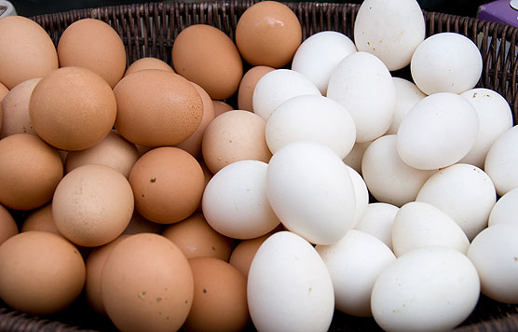
Type of Newborn
Eggs

Slide 20
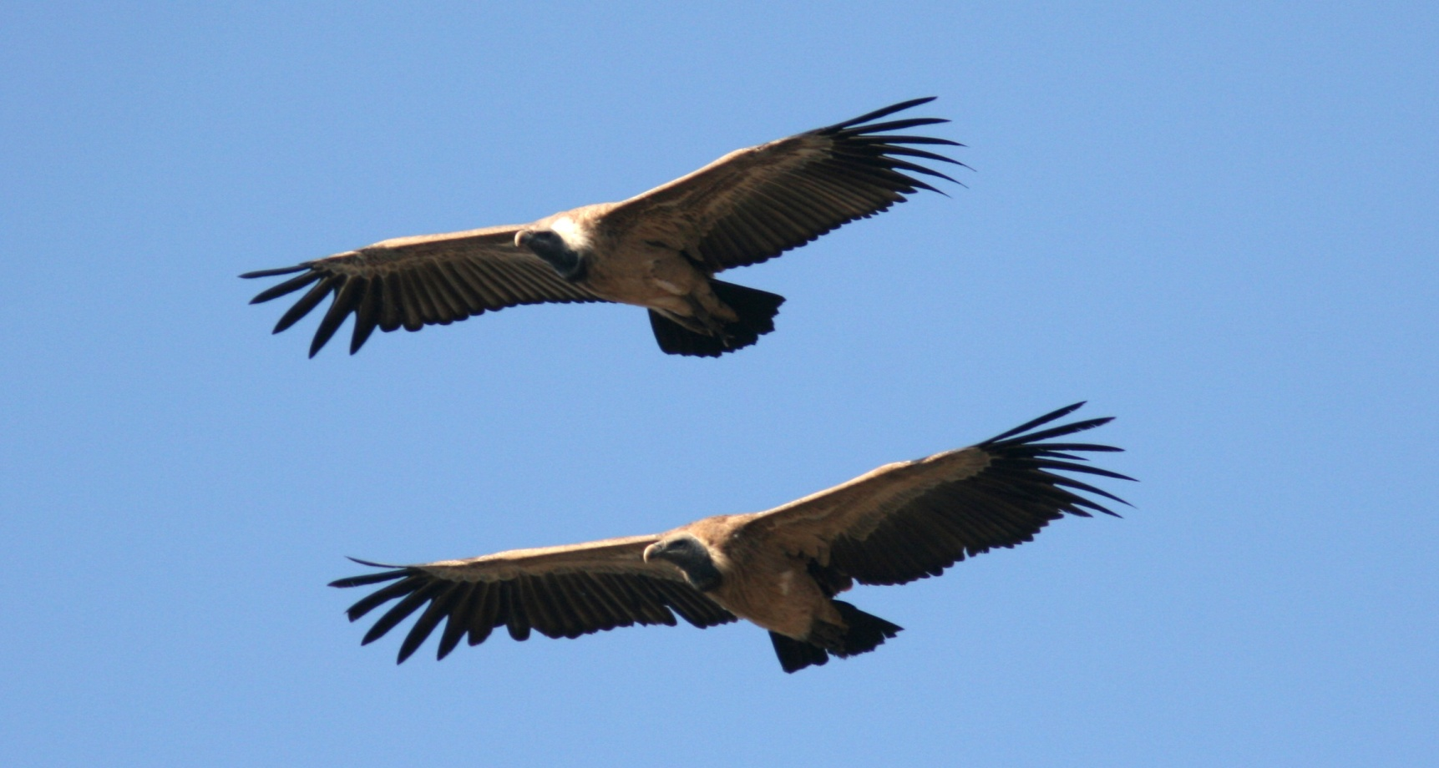
Convervation Status
Least Concern

