Slide 1
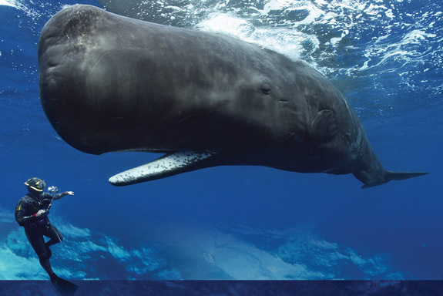
Whale
Adysen

Slide 2
The breed
It is a blue whale breed

Slide 3
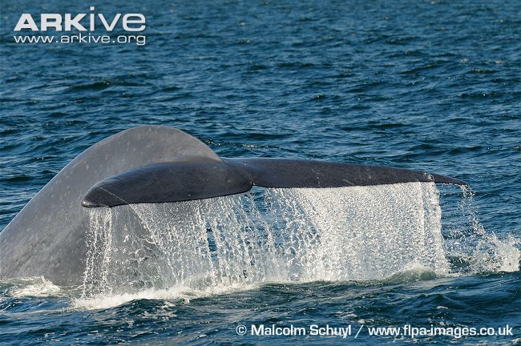
The scientific name
It is Balaenoptera musculus – (ba-lee-nup-tera-mus-cule-us)

Slide 4
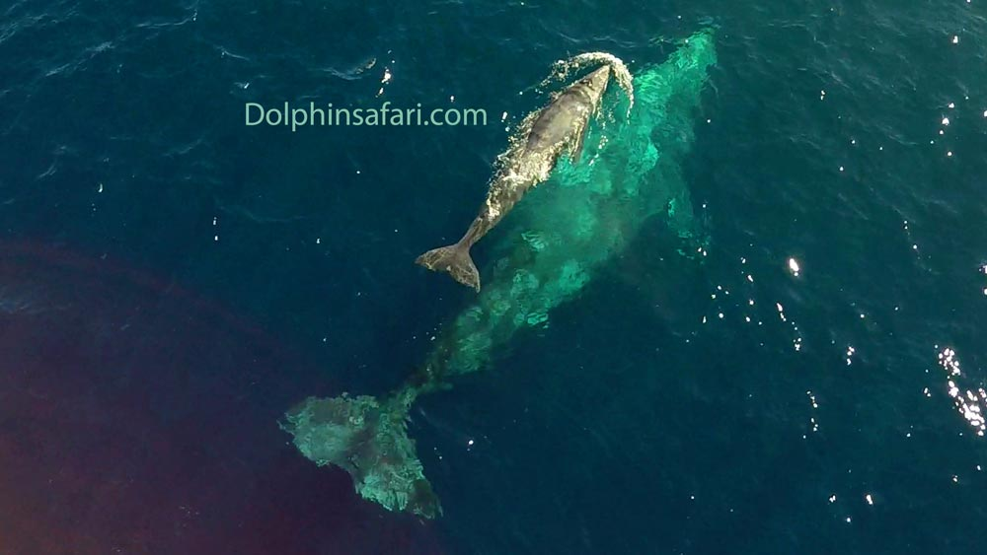
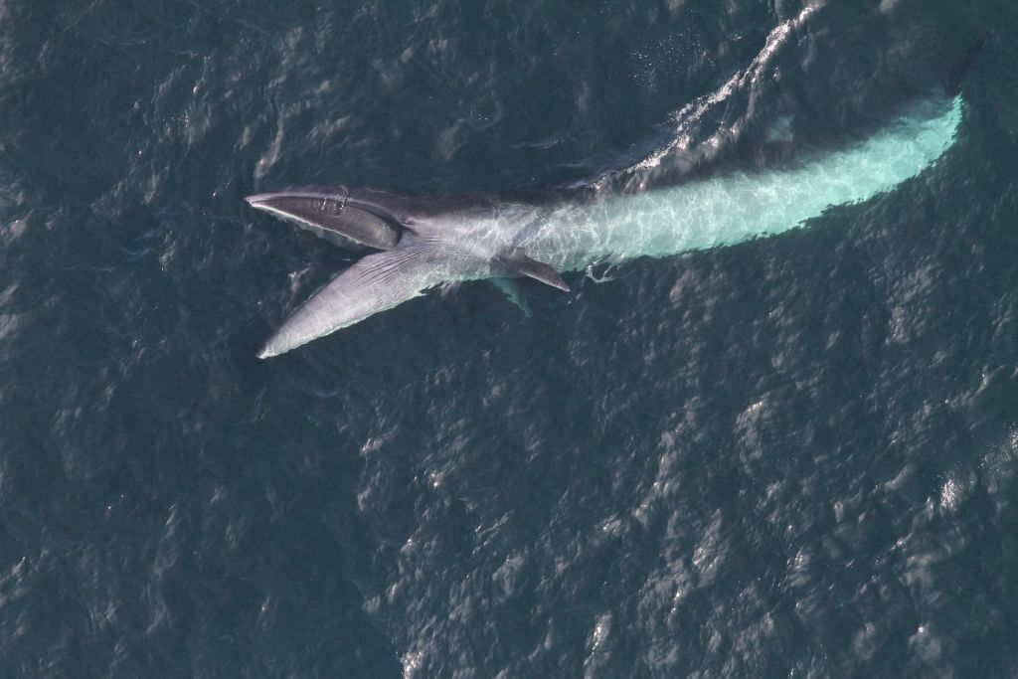
Some toothed whales
Some toothed whales are the gray whale, sei whale, sperm whale, and the narwhale

Slide 5
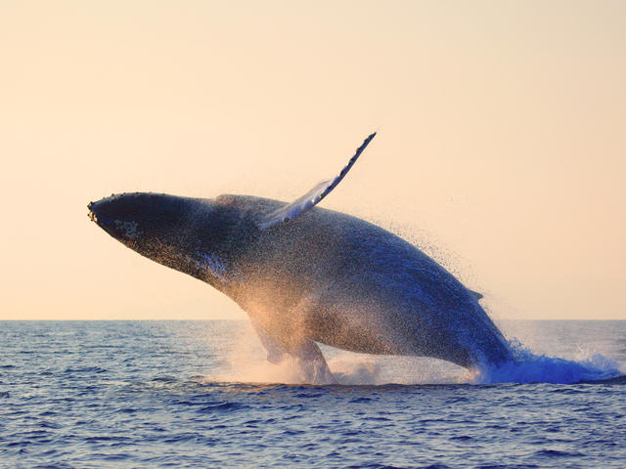
Life Span
It is about 80 – 90 years

Slide 6
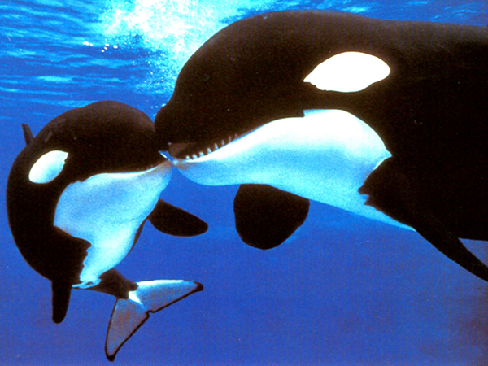
offspring
A whale usually has one offspring

Slide 7
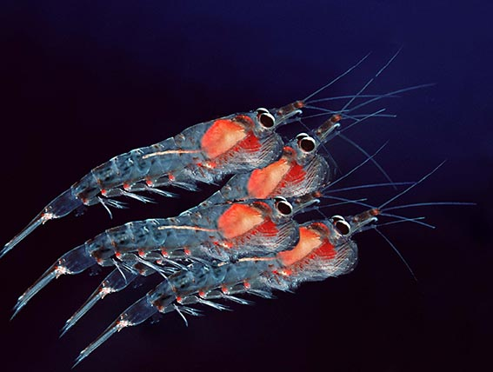
diet
The diet for a blue whale is a carnivore (krill)

Slide 8
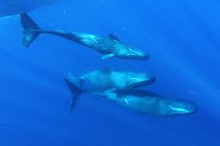
Gender names
A male is a bull female is a cow and offspring is a calf

Slide 9
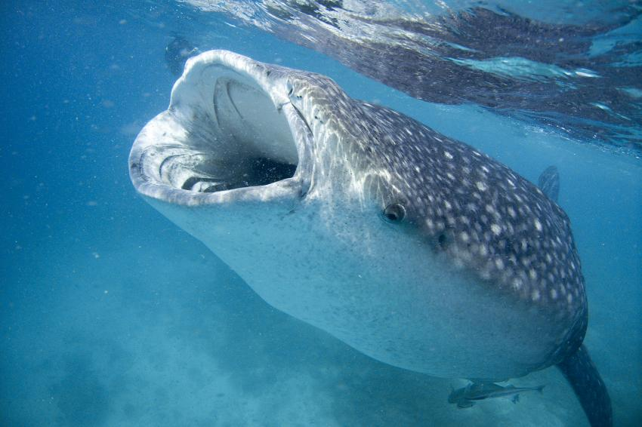
Population (currently)
The blue whale is currently endangered

Slide 10
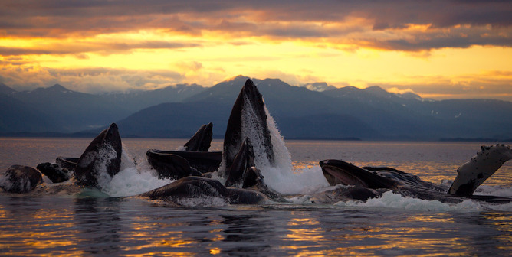
Group name
The names for a group of whales are pod, herd, or gam.

Slide 11
How many are in groups
There are 2-50 whales in a group

Slide 12
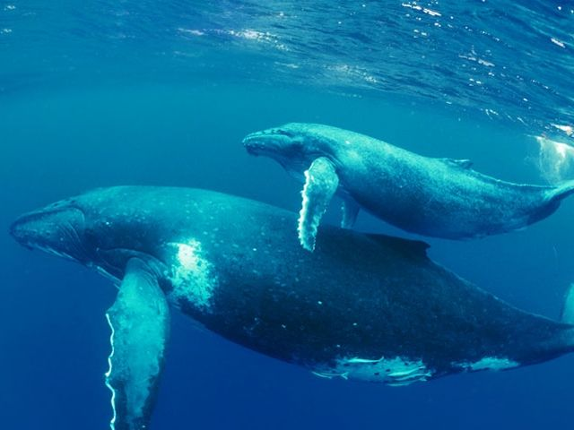
birth
A whale is a mammal so It gives live birth

Slide 13
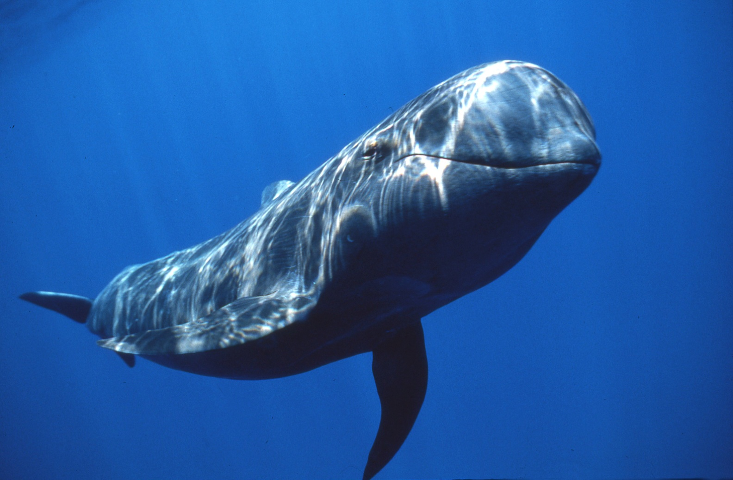
CrAzY fact
Pilot whales are actually members of the dolphin family

Slide 14
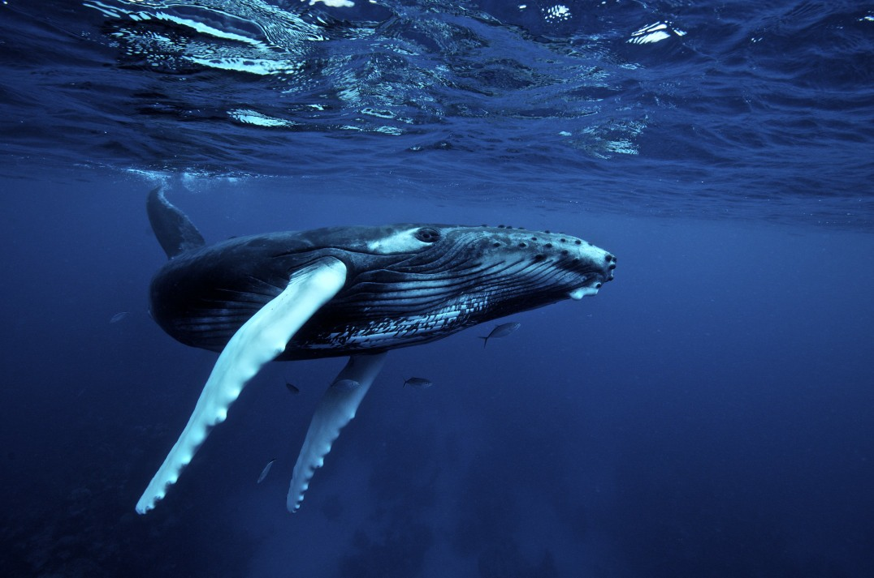
Interesting fact
A humpback whale has long flippers and swim in the coastal waters

Slide 15
OMG (oh my gosh!)
A pygmy sperm whale actually has a square head!

Slide 16
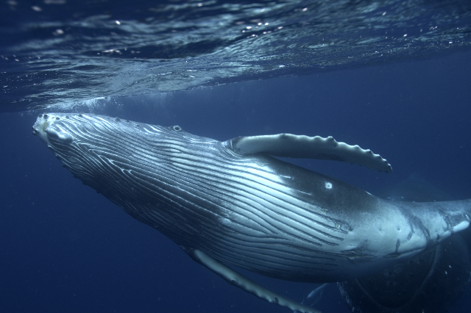
Kind of confusing
a blue whale, sei whale, and gray whale are actually a baleen whale

Slide 17
Length (blue whale)
It can grow 100 feet long. That’s really long!

Slide 18
Length ( gray whale)
It can grow 43 feet long. That’s less than half of the blue whale!

Slide 19
Length (Sei whale)
It is over half of the length of the blue whale. I bet you can guess! Got your answer? It can grow 62 feet. Did you guess it? Or were you close.

Slide 20
What is a whale?
A whale is really a mammal crazy right!

Slide 21
Thanks!!!
Thanks for looking at my slide show I hope you learned a bit about whales. (special thanks to Mrs.Keep for teaching me great skills for this slide show)

